Slide 1

Online Shopping
T e a m N u m b e r : 19
Vidhi Khathuria | Animesh Landge | Kenil Shah

Slide 2
Technologies used
MERN stack for the shopping website.
Flask for Warehouse portal.

Slide 3
Our favourite features
Recommendations using Decision Tree
Dialogflow chatbot
SMS + Email + Call on placing order as well as updating order
Payment Gateway – Paypal
Invoice generation
Google maps API to show your order’s current location
QR Code scanning system to update order location

Slide 4
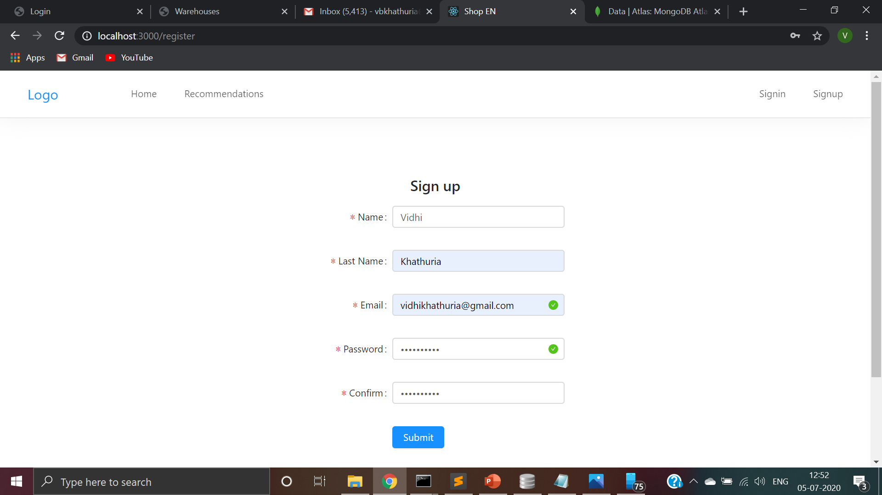
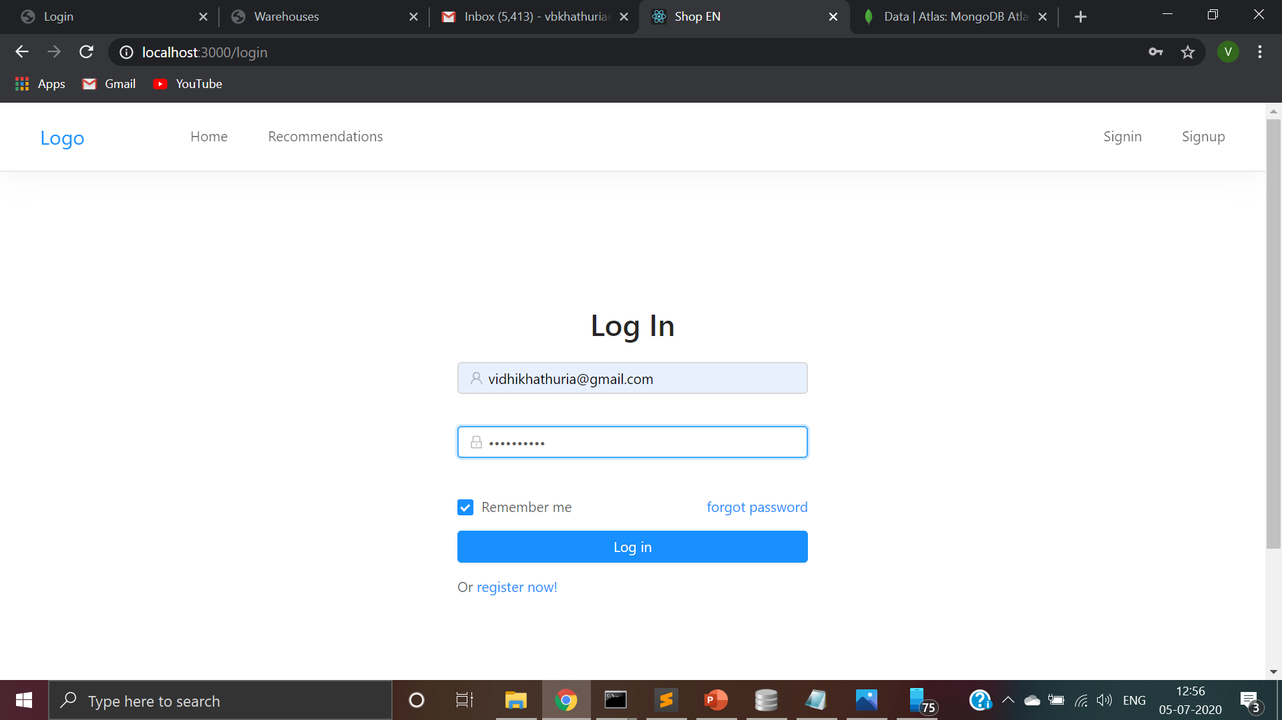
Customer registration and log in

Slide 5
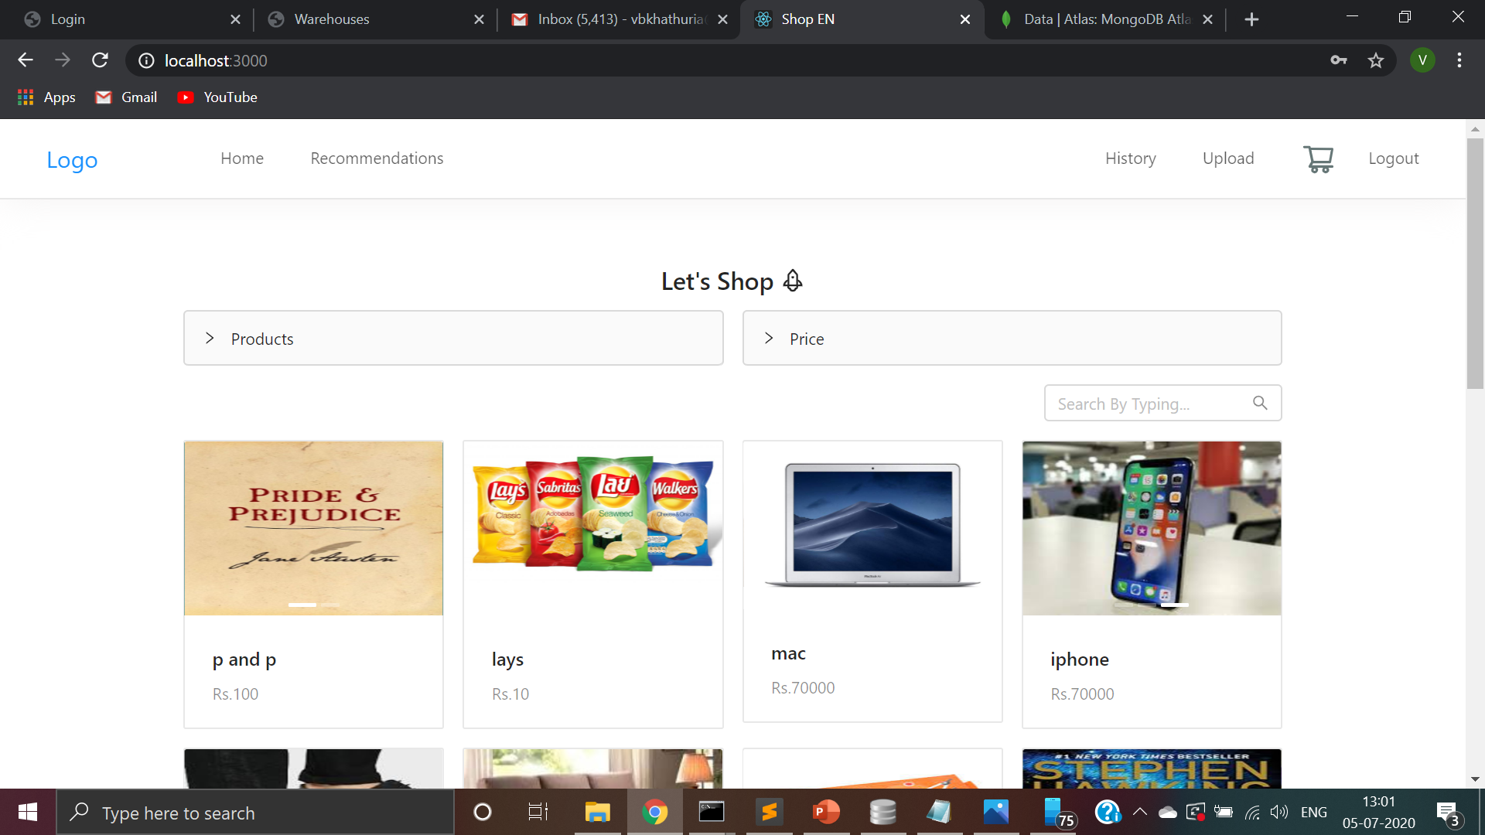
Home page

Slide 6
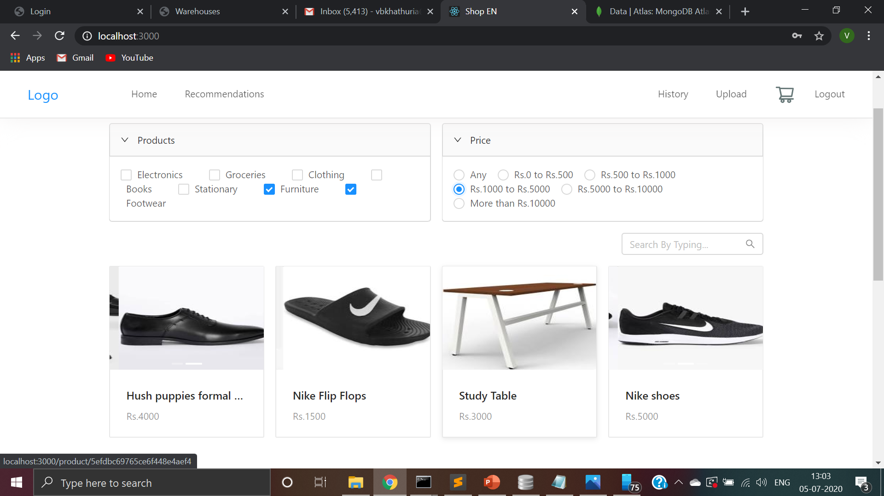
You can filter products according to category as well as price

Slide 7
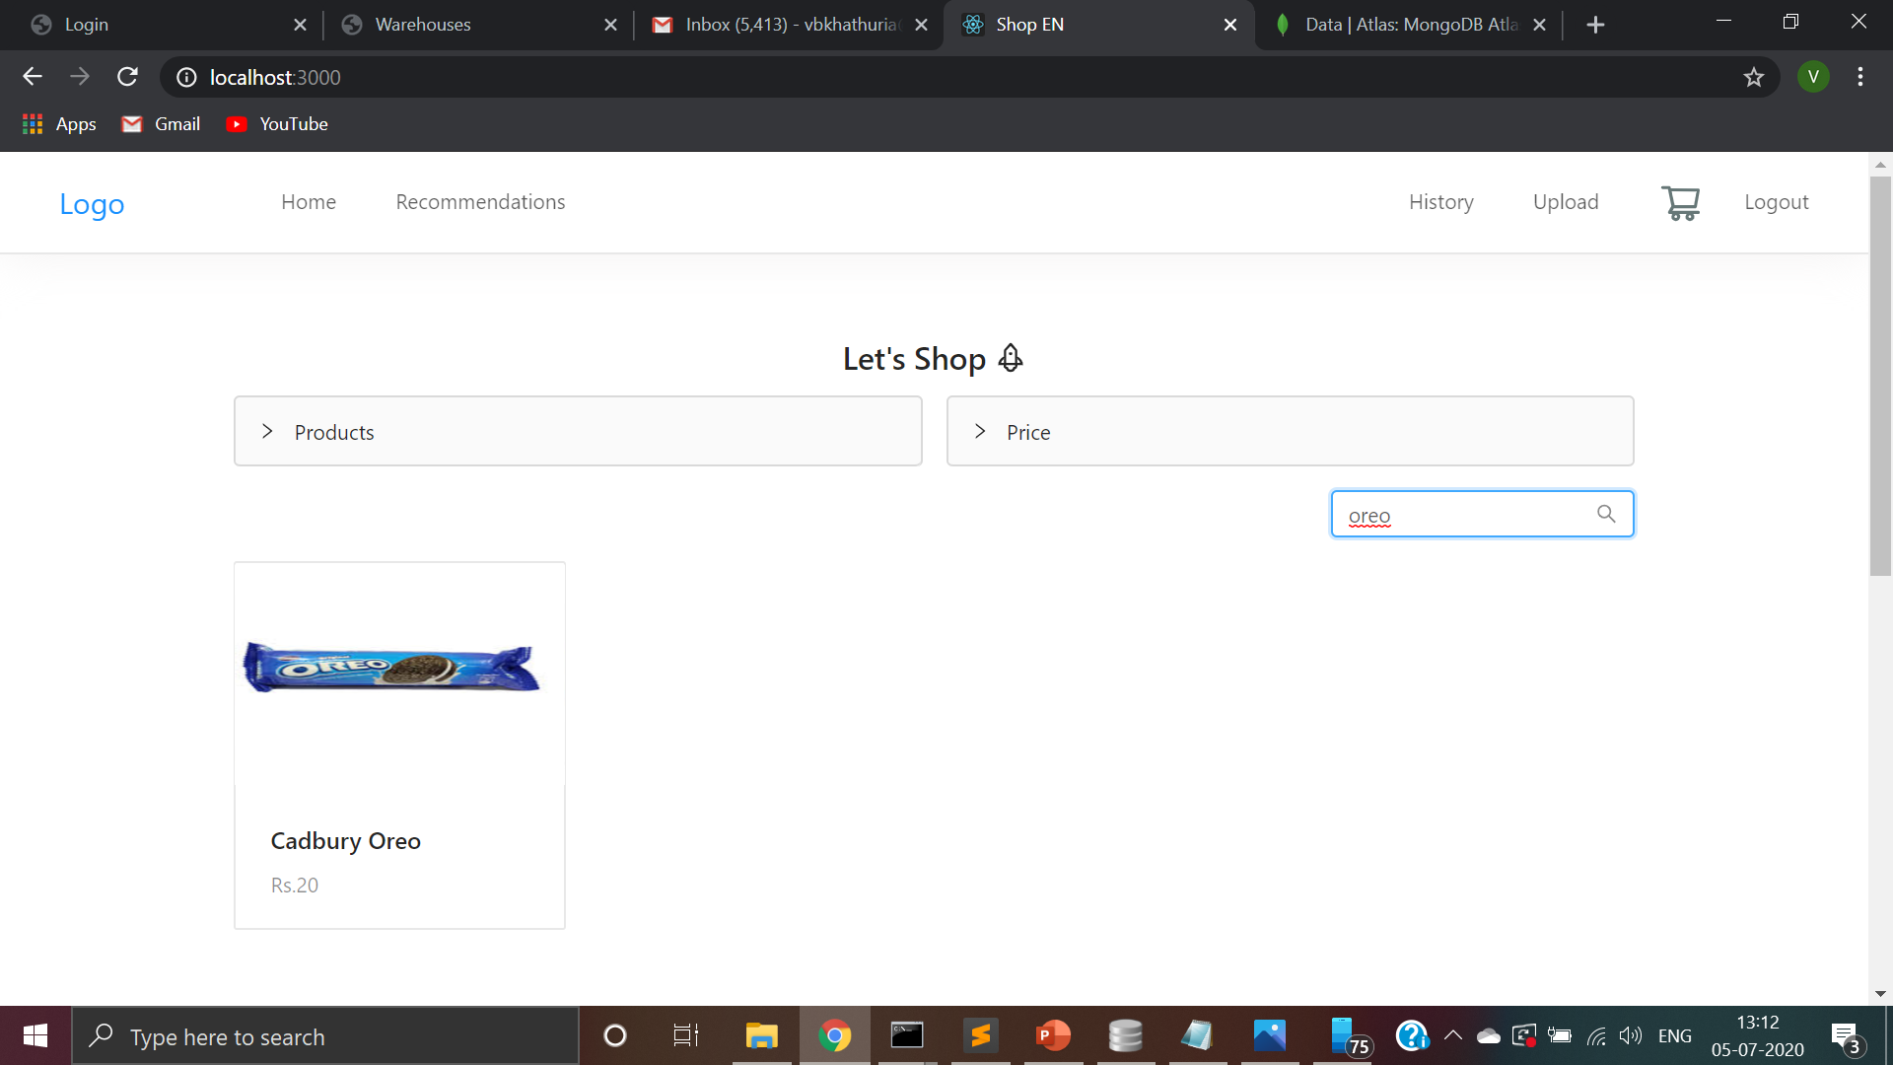
We have also added the search in app feature

Slide 8
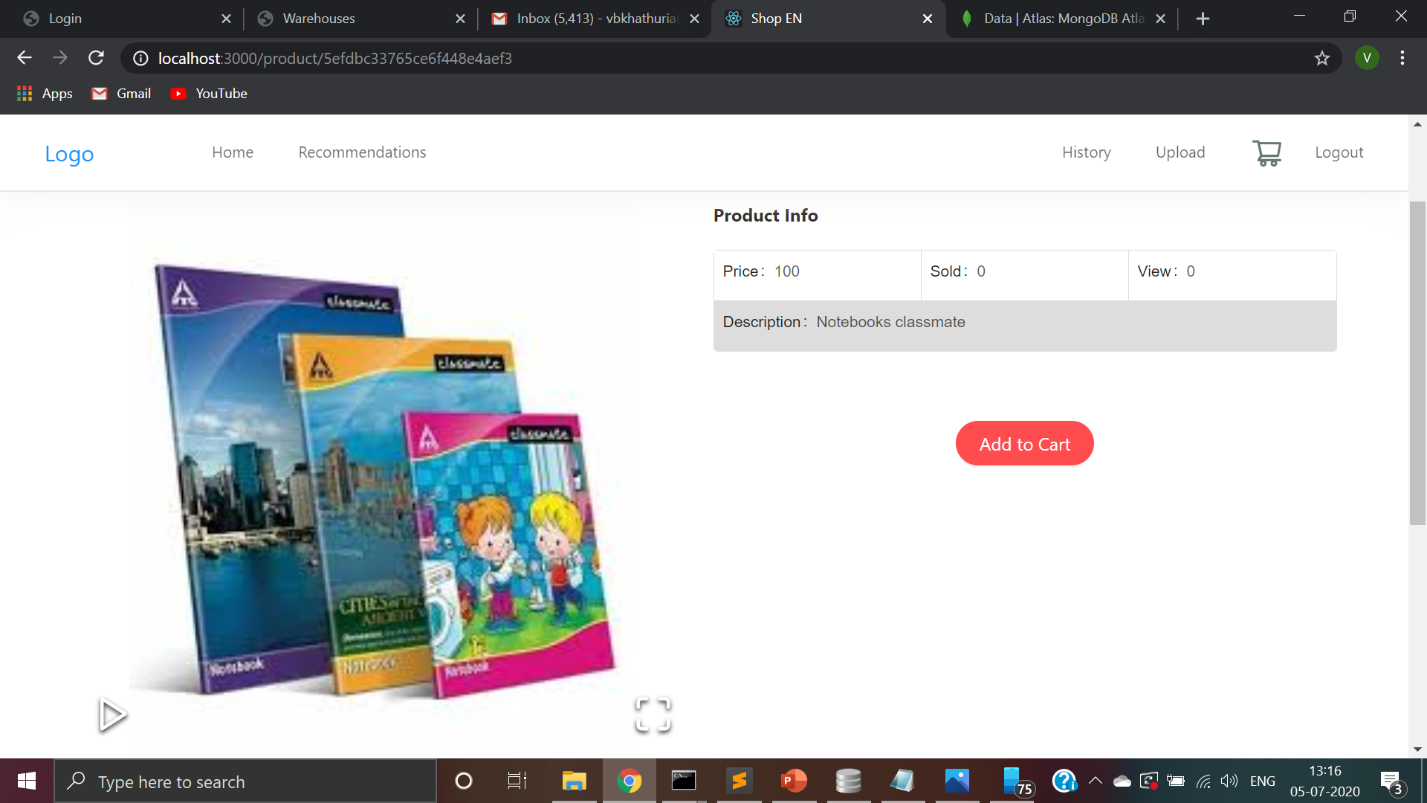
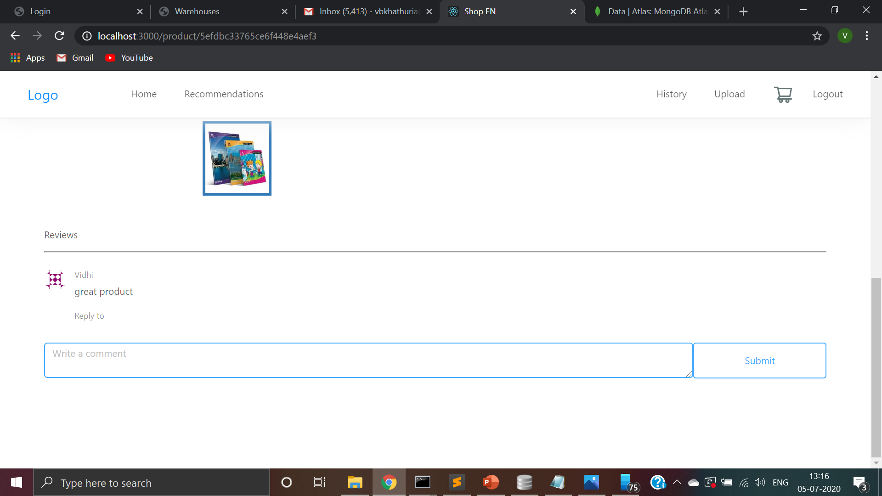
Product description page
User can see how many people have viewed the product as well as how many people have bought the product
User can zoom in to the product to see the product better.
Users can see previous reviews and write reviews themselves.

Slide 9
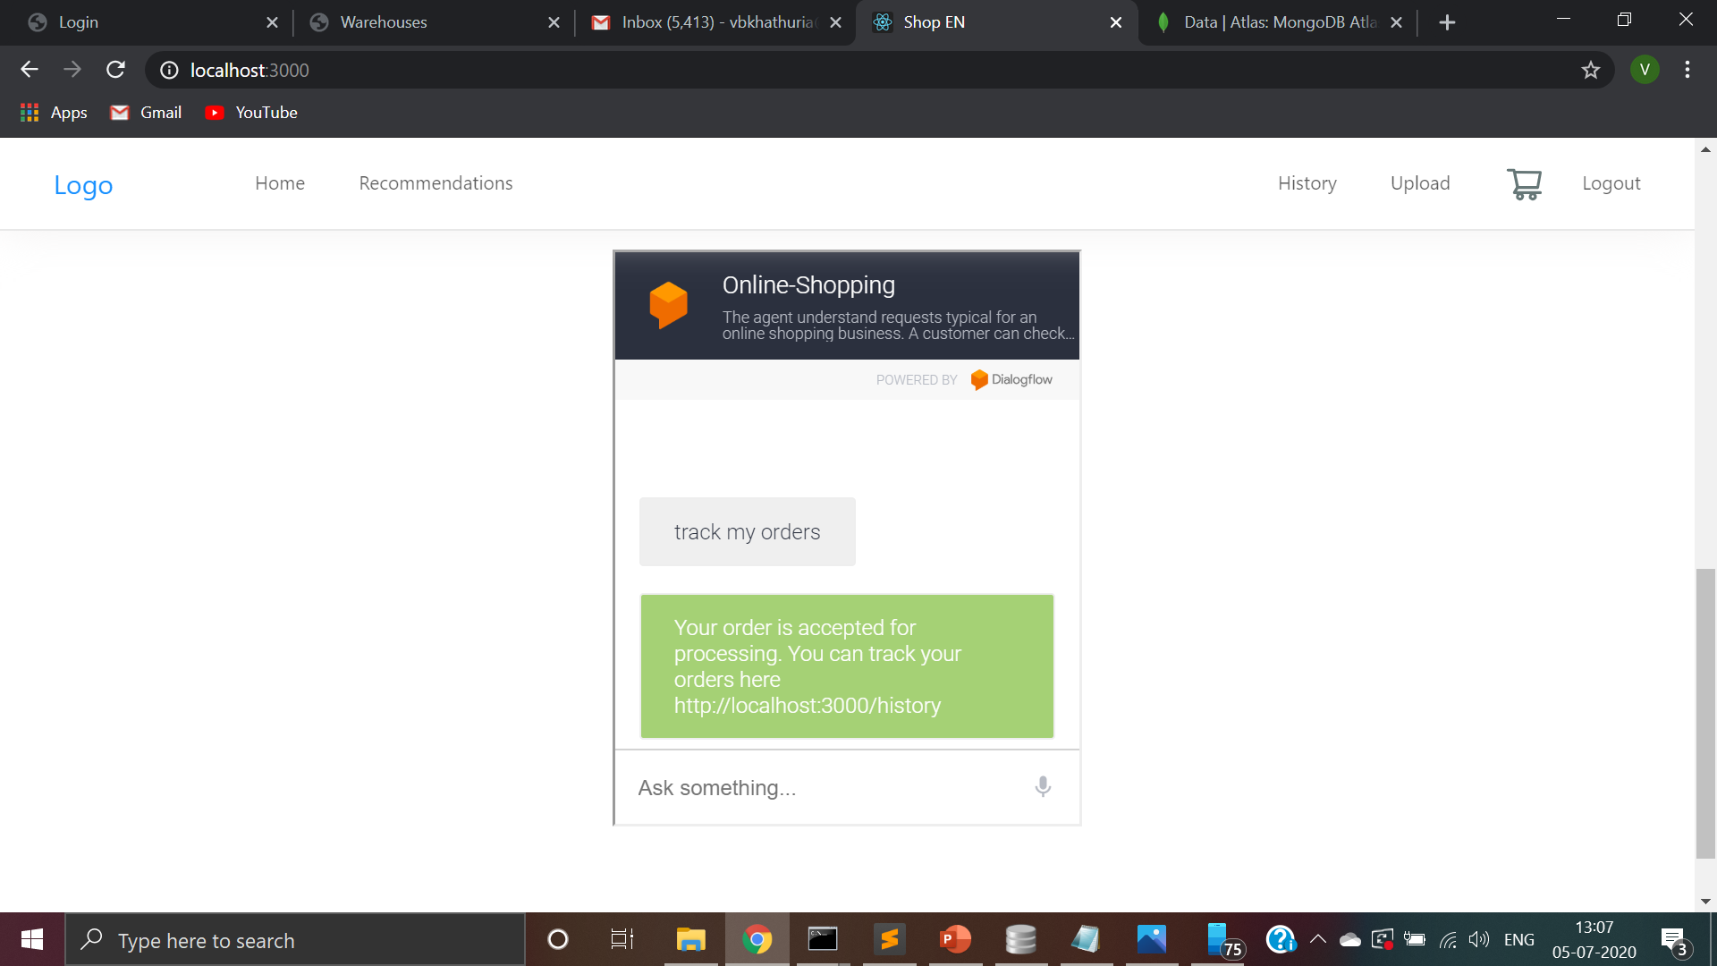
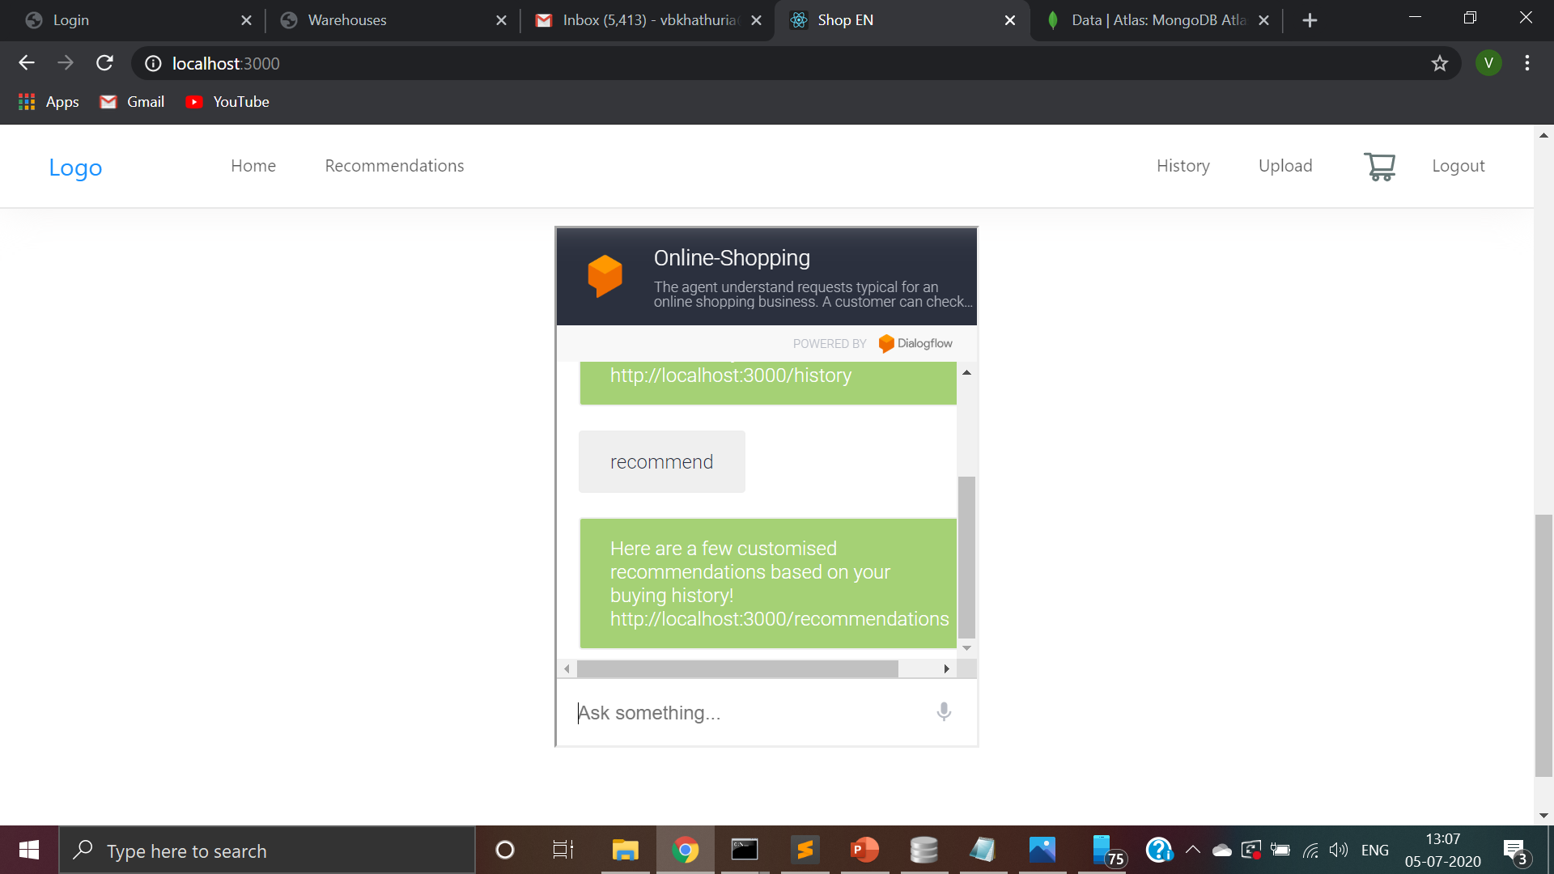
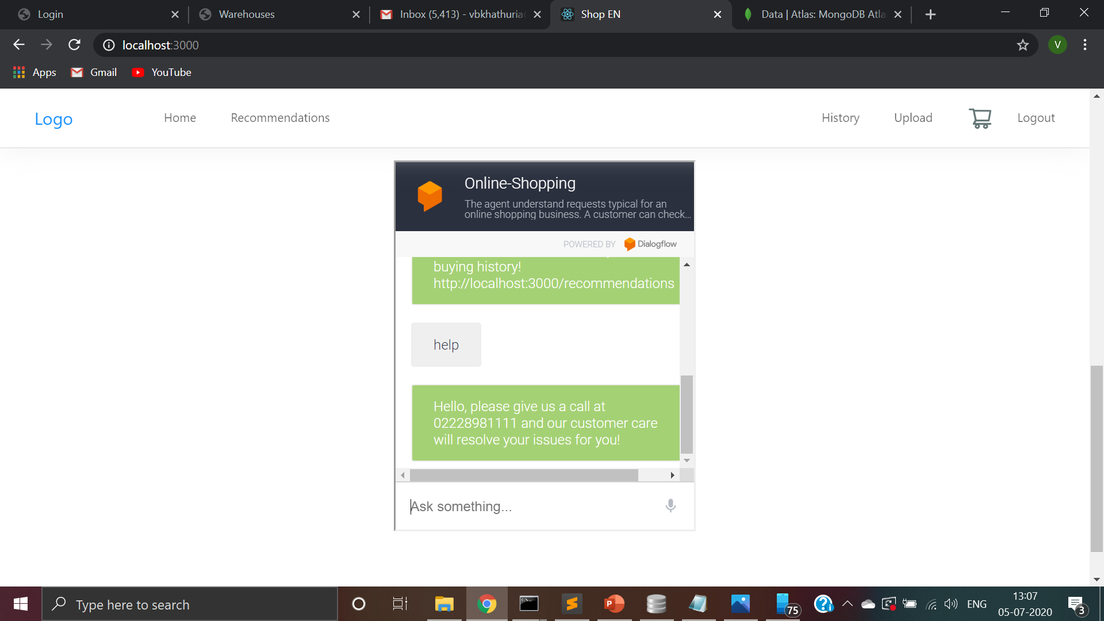
Our first awesome feature : voice enabled chatbot

Slide 10
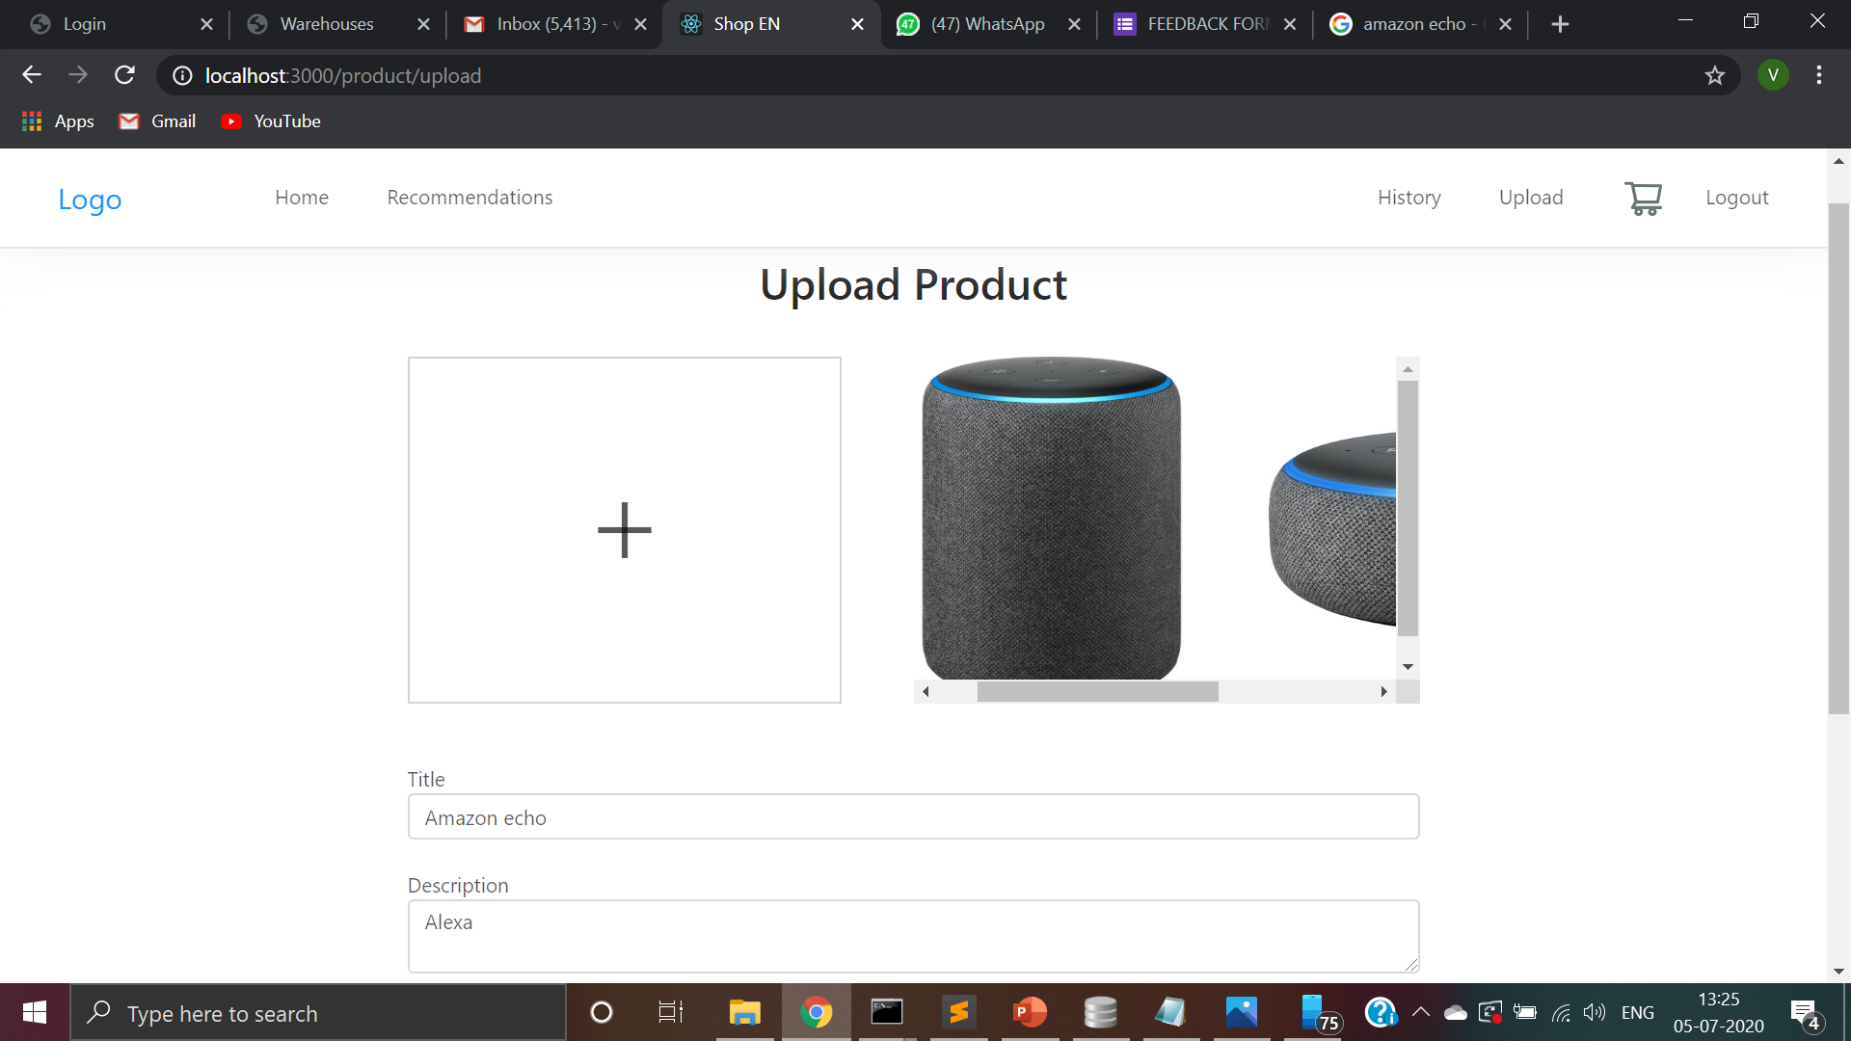
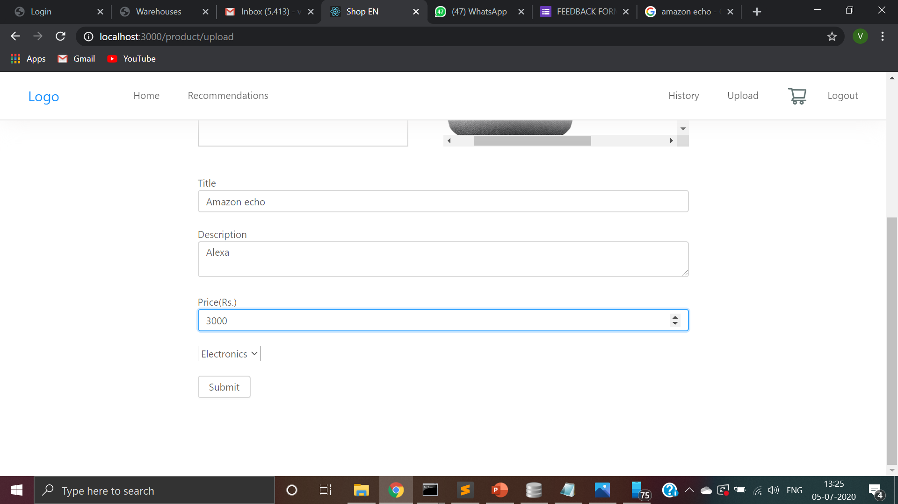
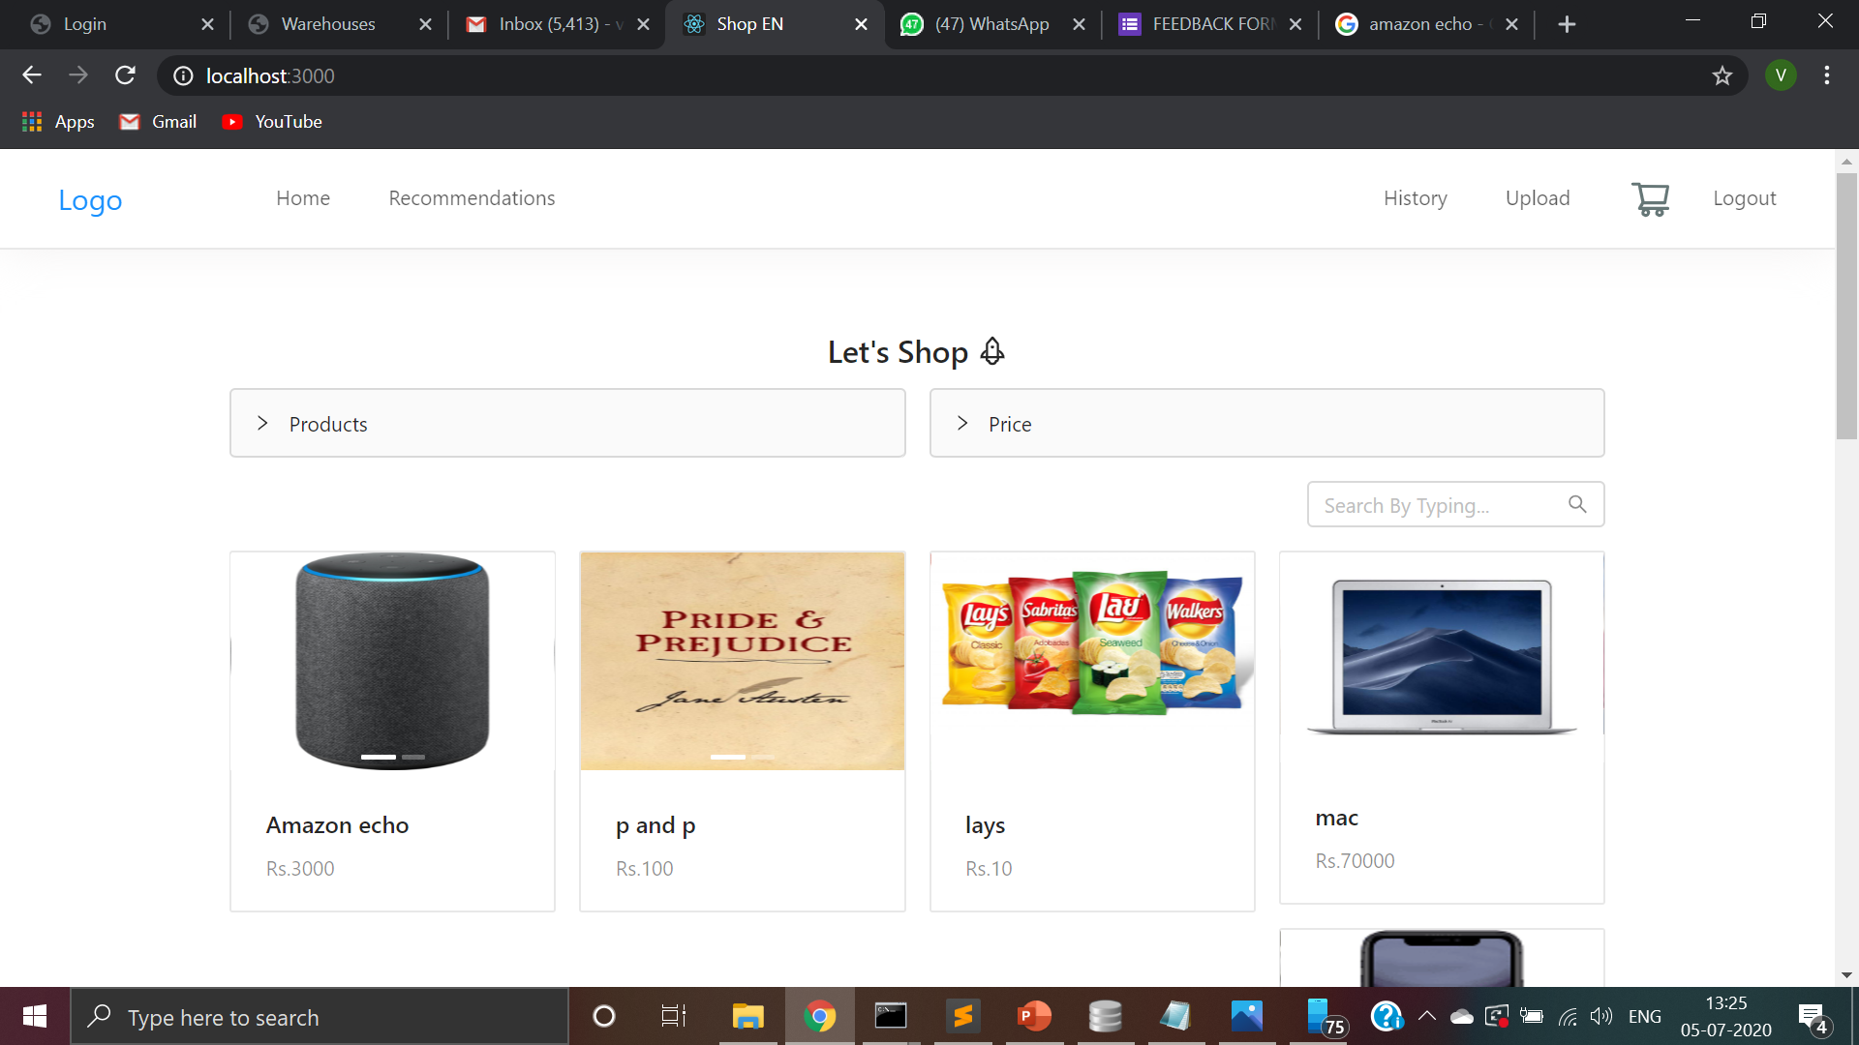
User can upload products as well!
User can be a buyer as well as a seller.
They just need to enter the pictures of their product with a small description and price at which they wish to sell the product and the category the product falls under.
The product is reflected on the home page right after the upload.

Slide 11
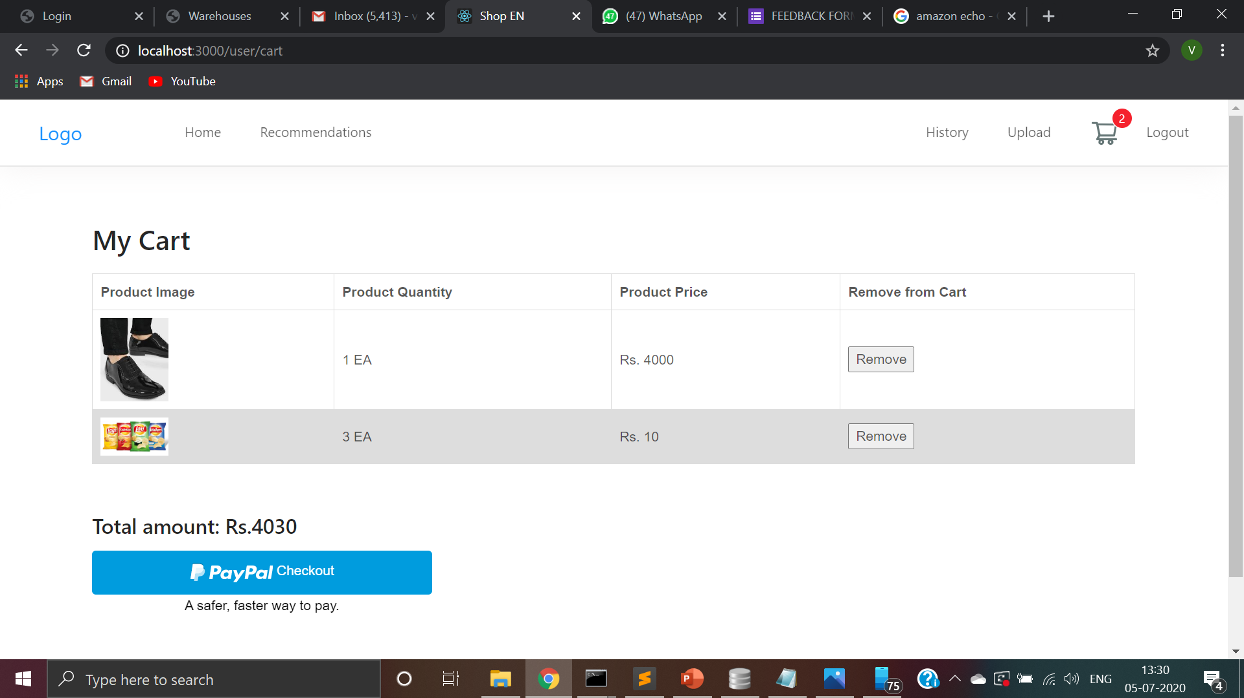
Shopping cart management
User can add or remove multiple products or multiple quantities of the same product.

Slide 12
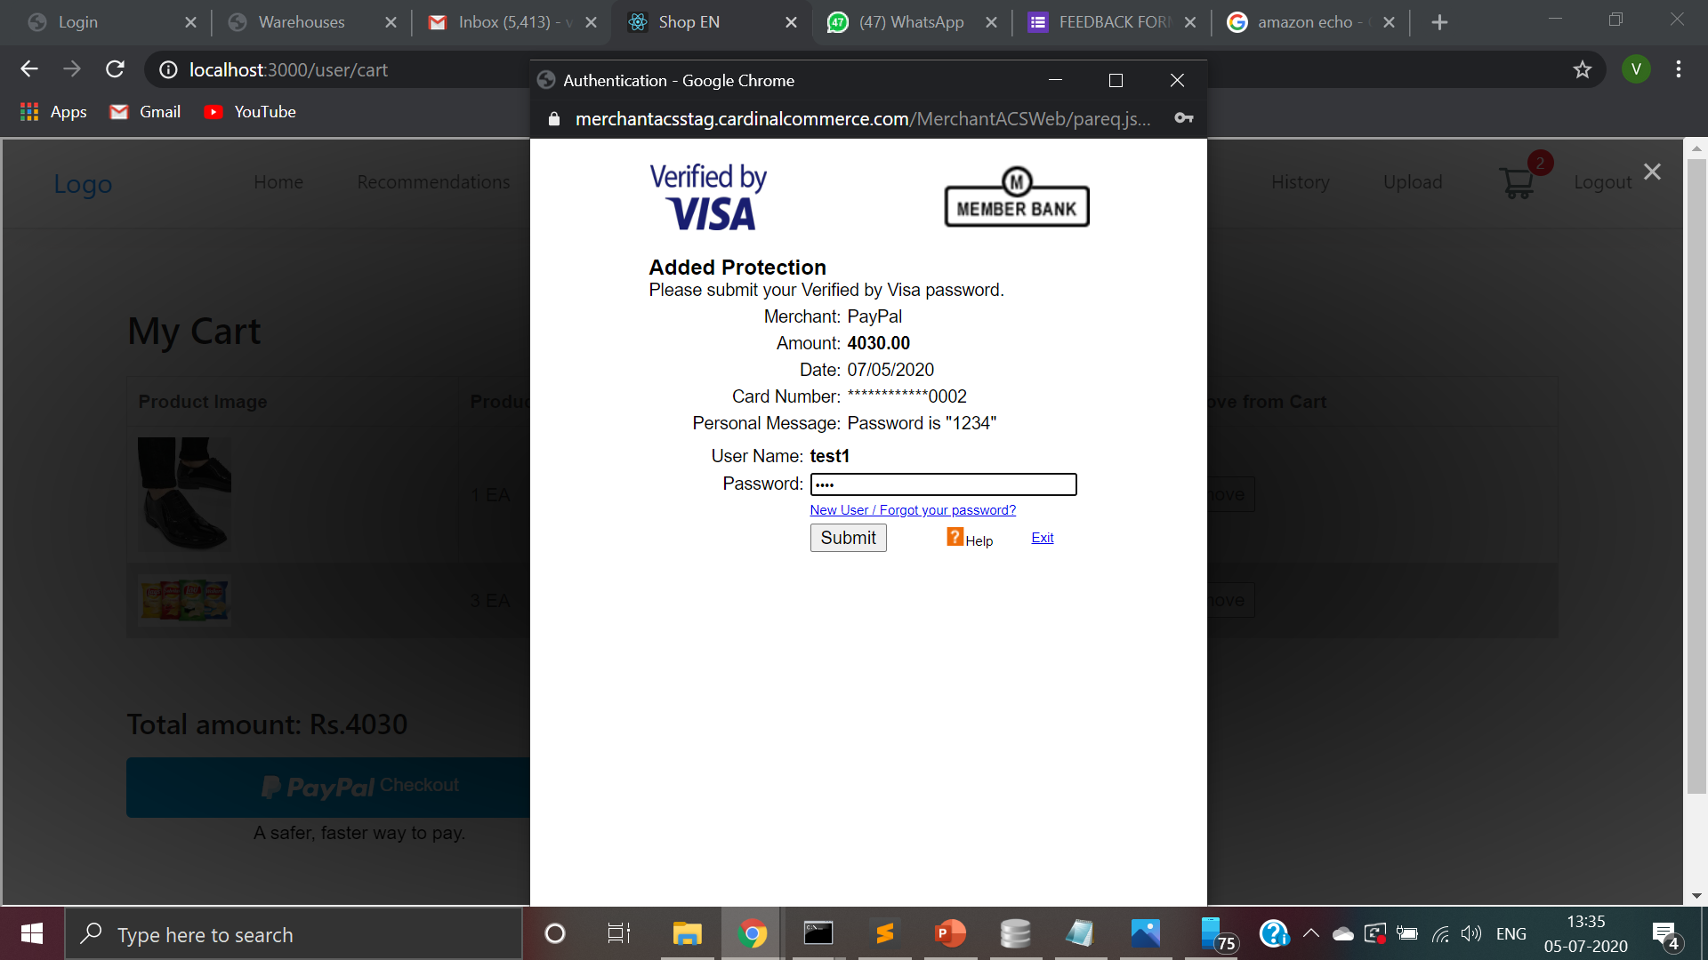
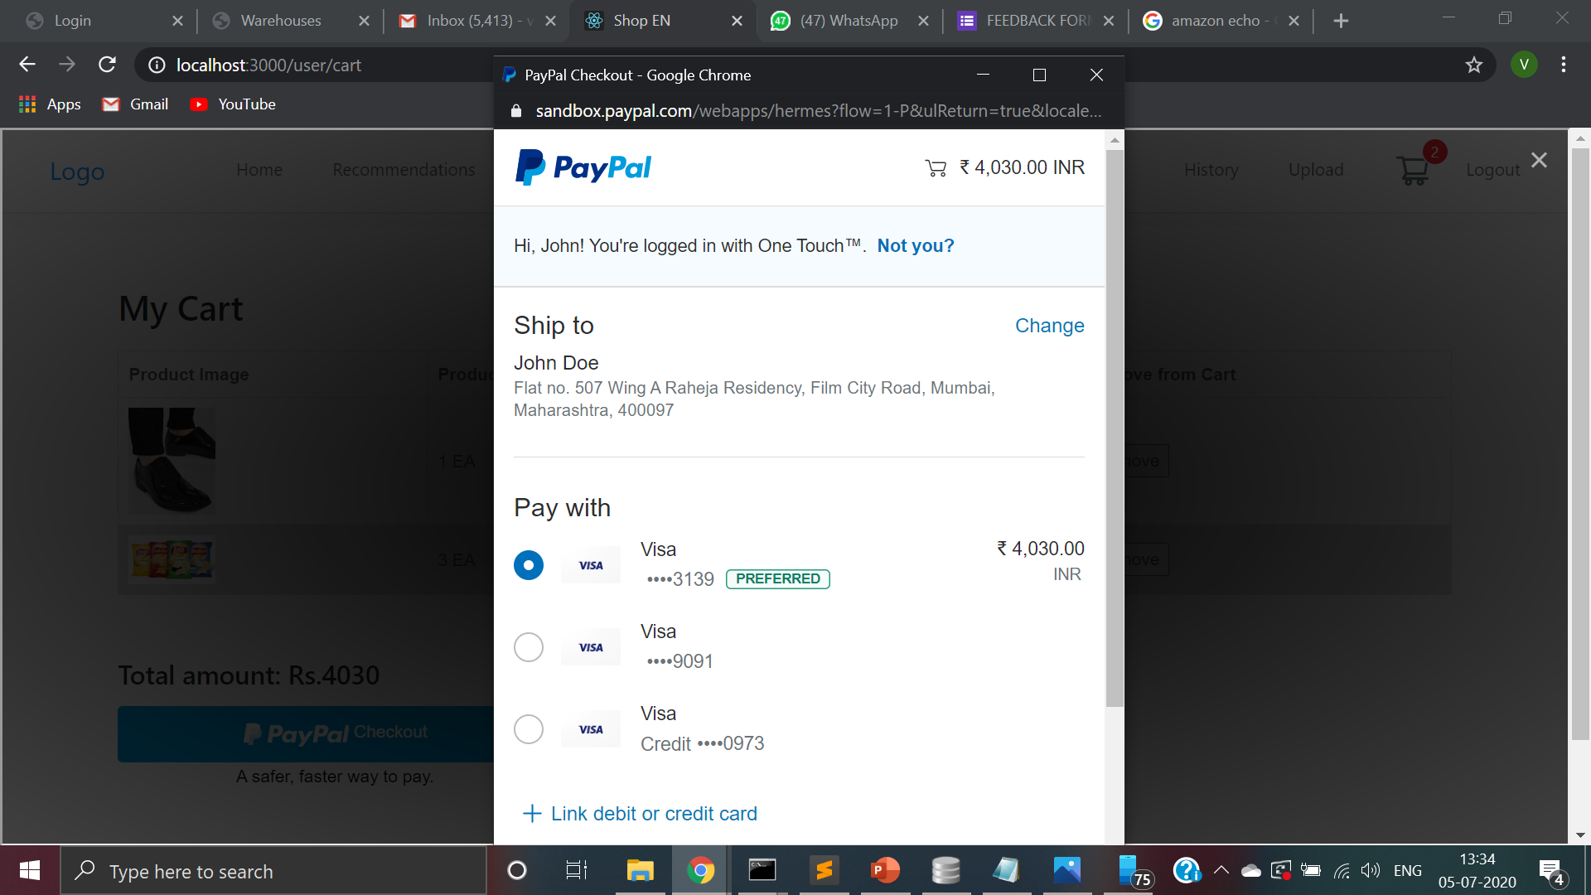
Payment gateway : Paypal
We are using a secure payment gateway called paypal.
User can pay using a credit or a debit card.

Slide 13

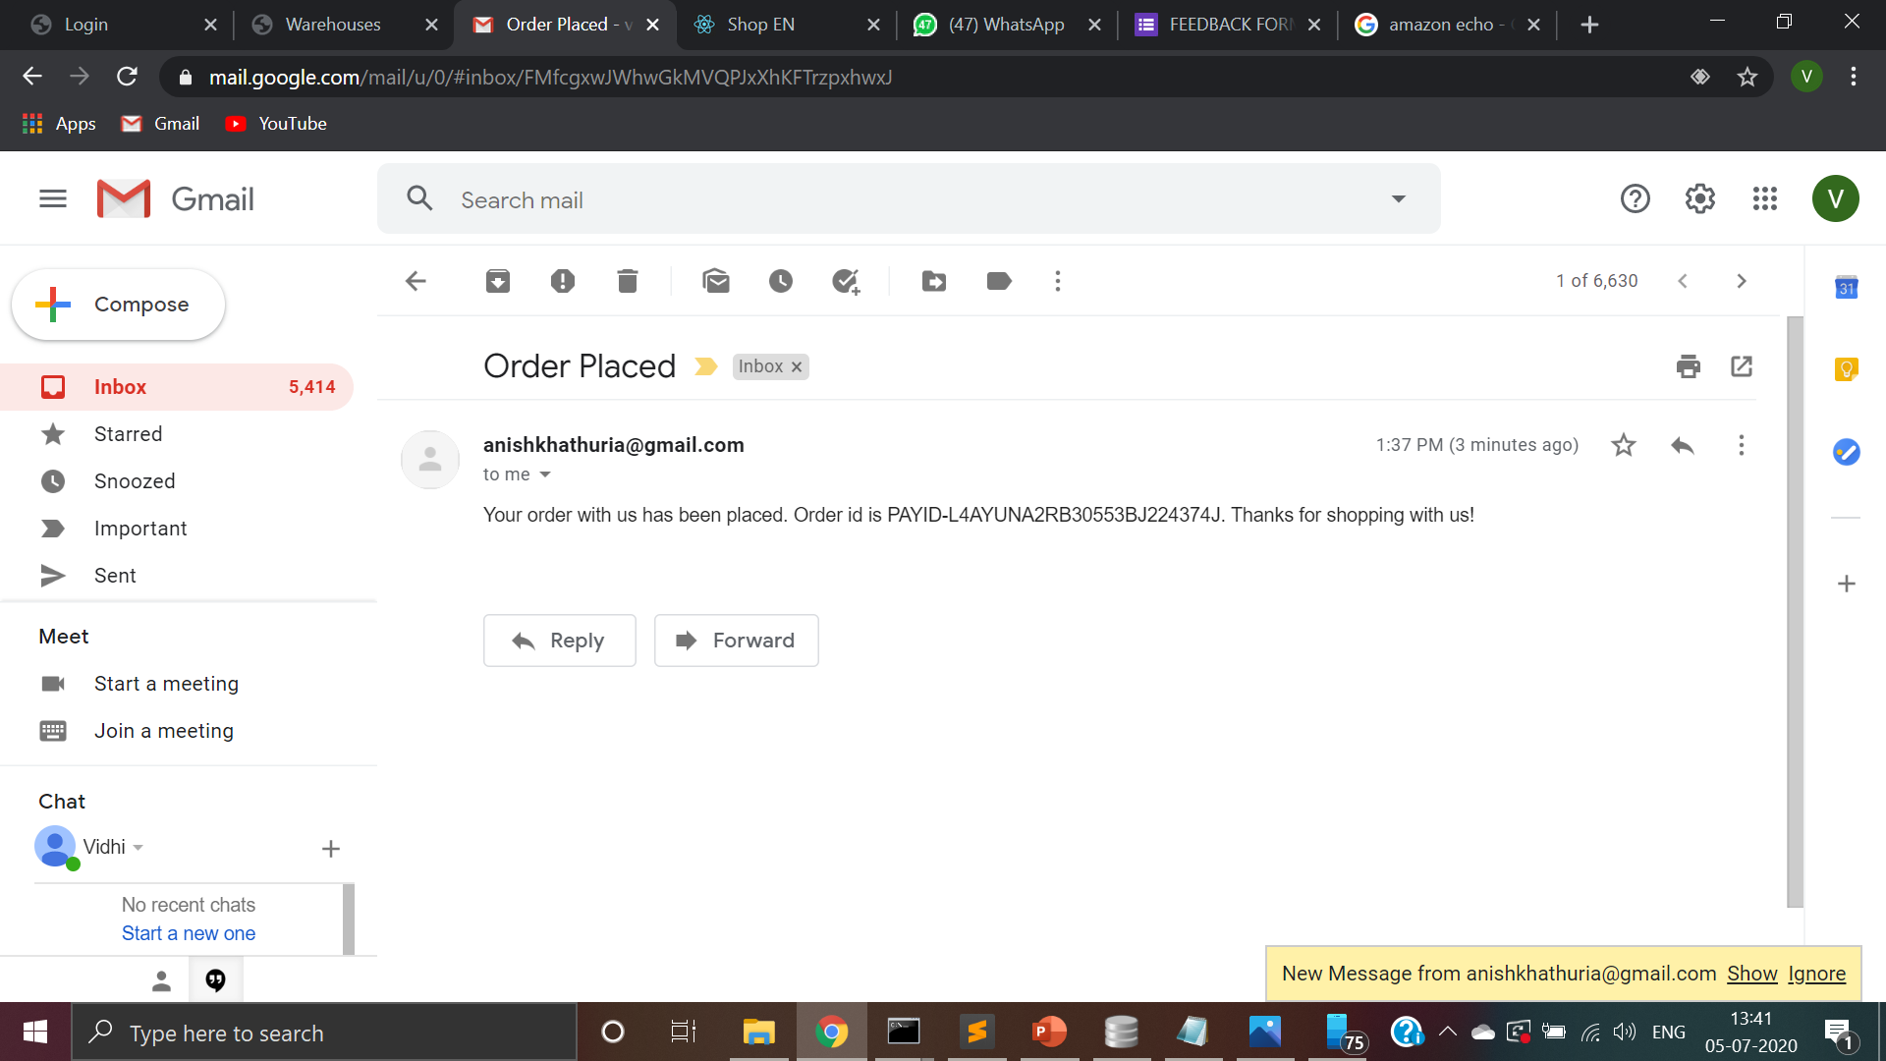
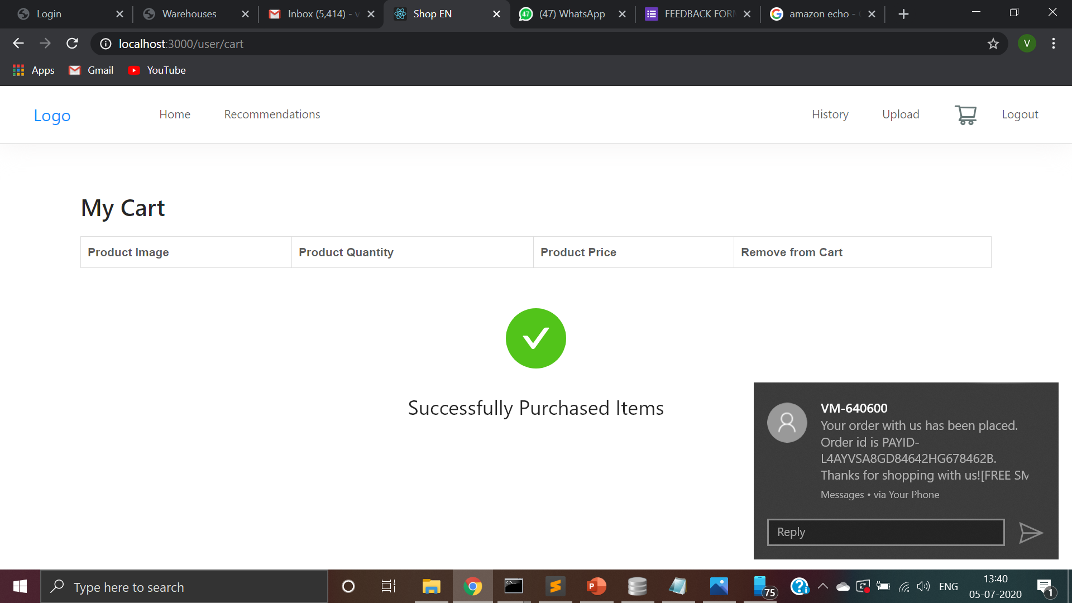
After placing the order
The user receives an email and a text message and a call to give the updates about the order.
A QR Code is generated that must be pasted on the order.

Slide 14
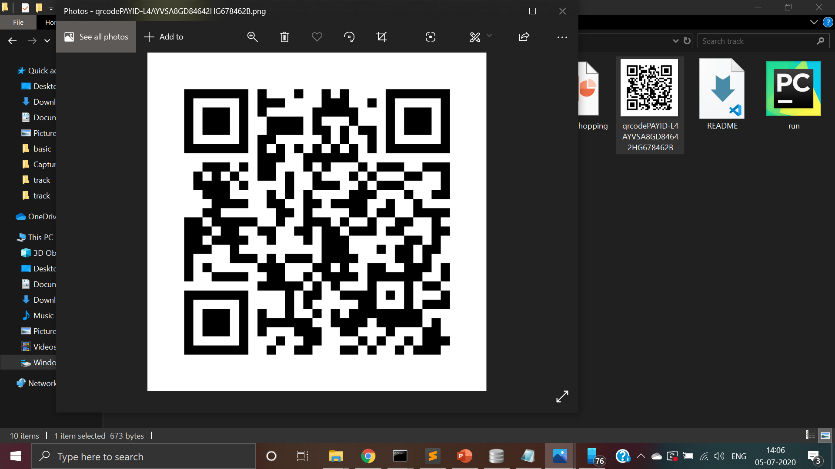
QR Code generated with the name of the order id

Slide 15
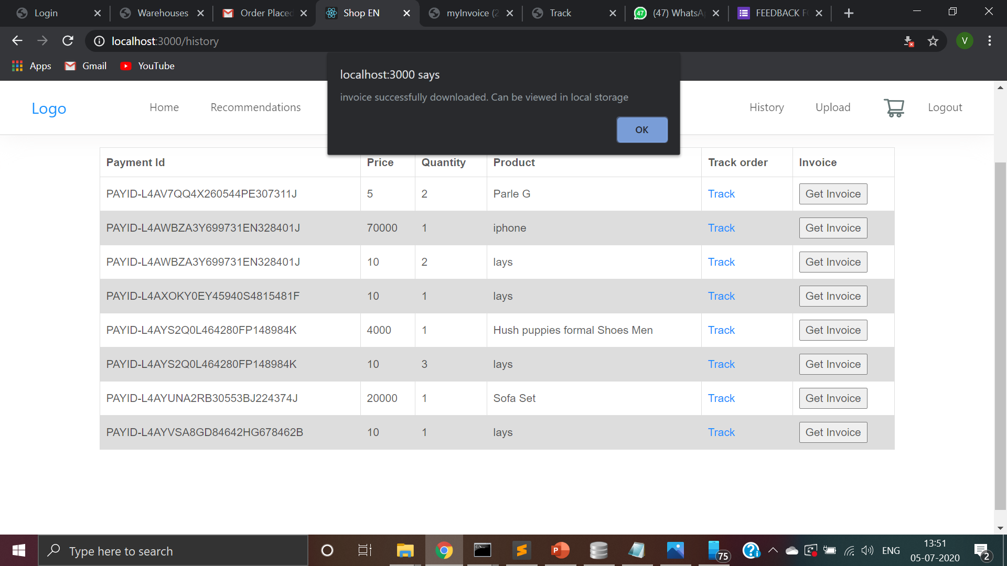
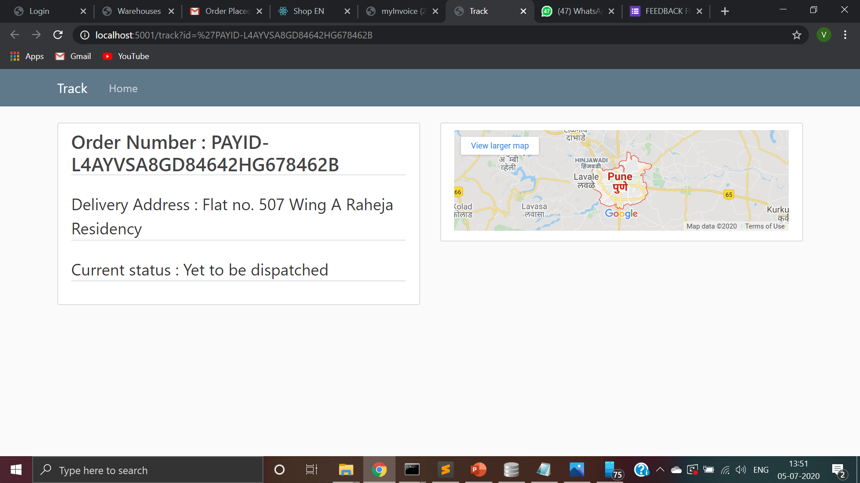
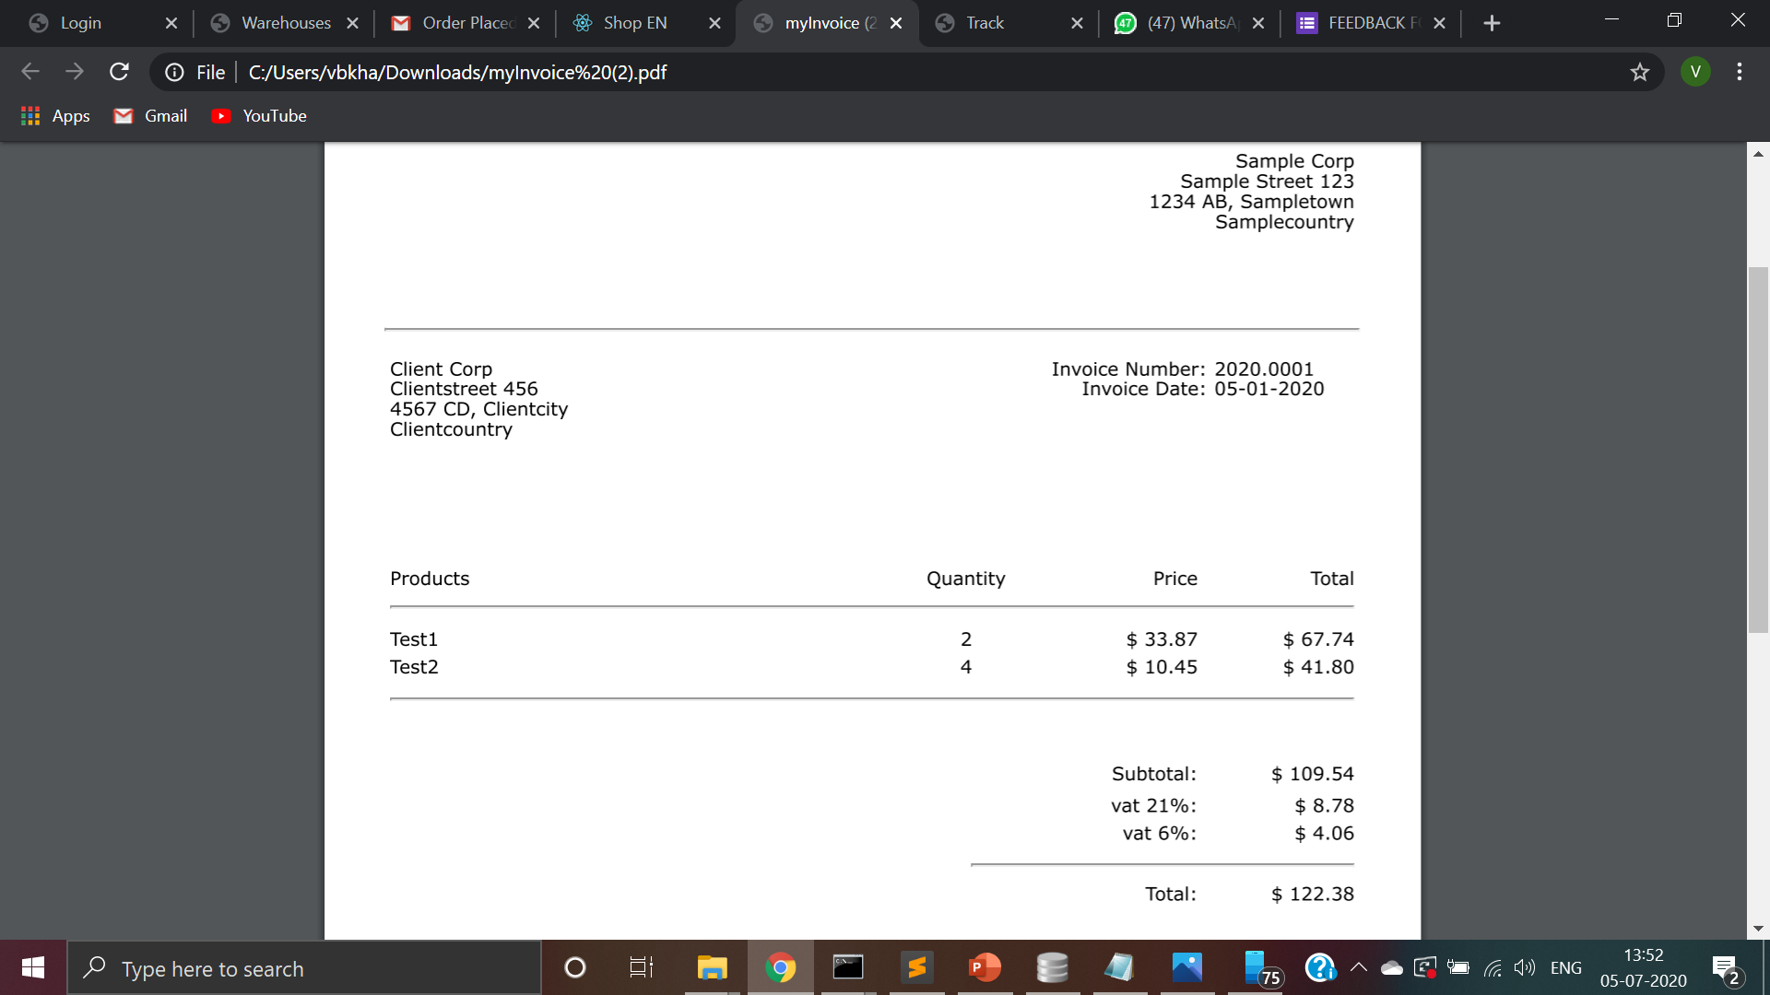
Invoice and tracking

Slide 16
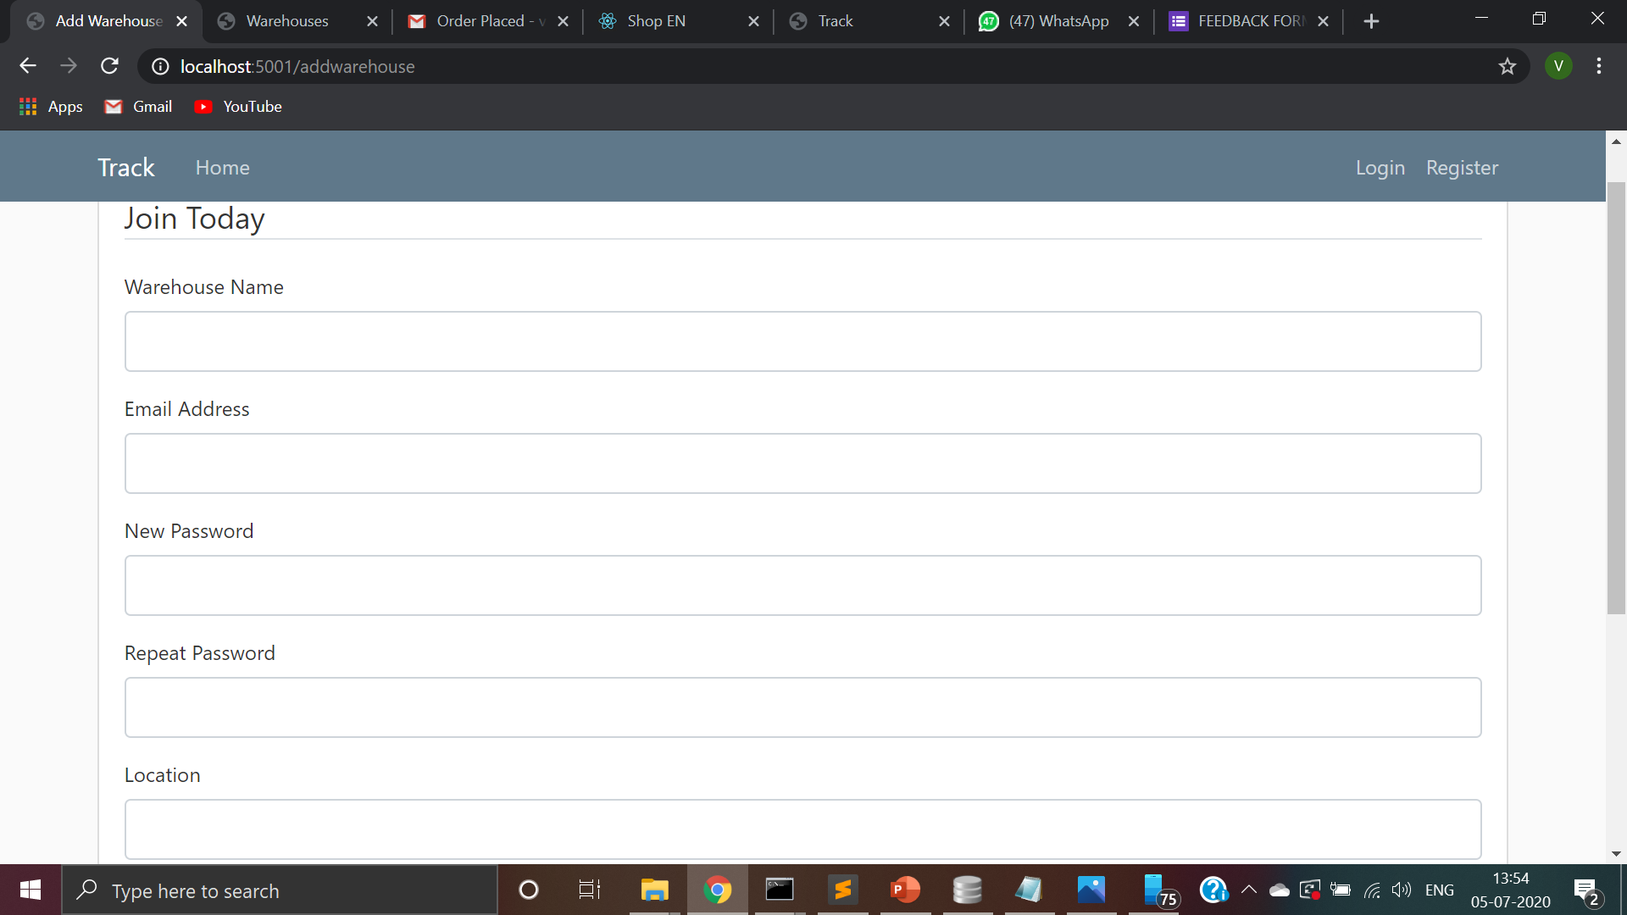
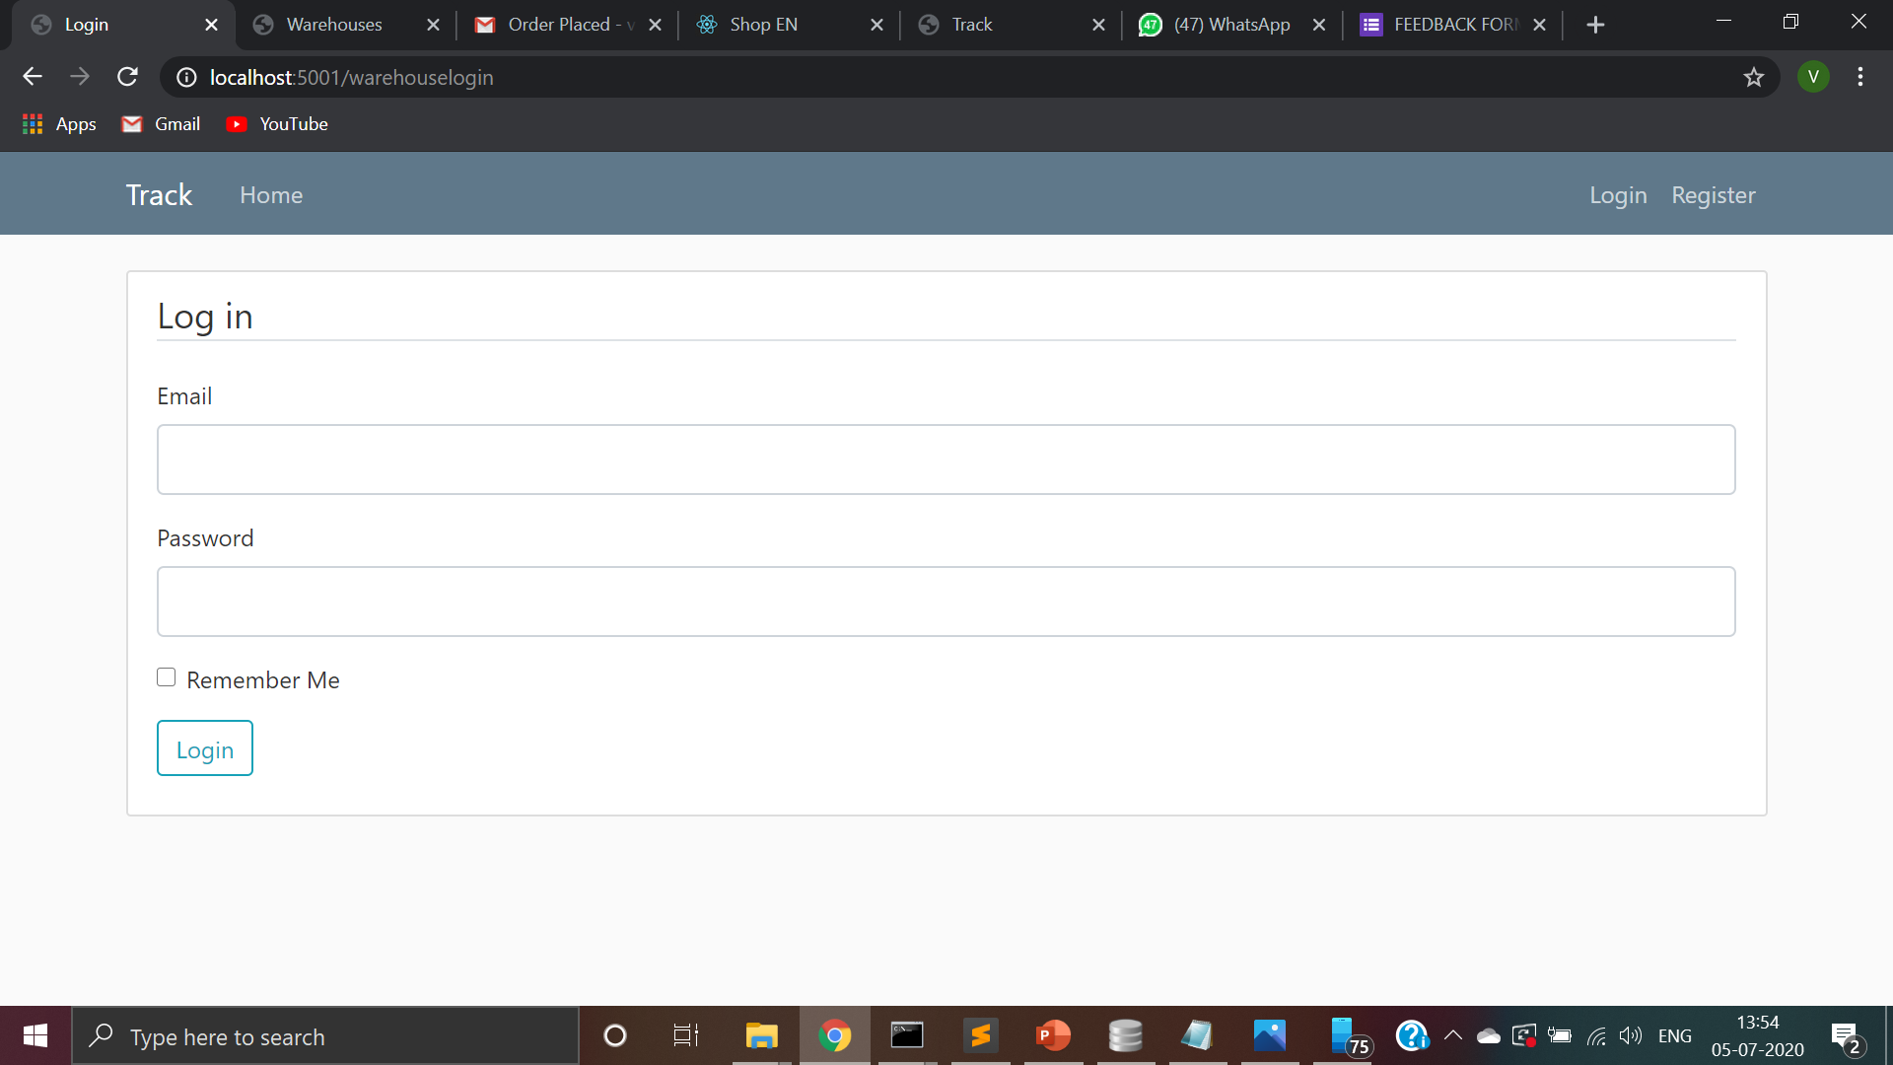
Product Inventory : Registration and Login

Slide 17
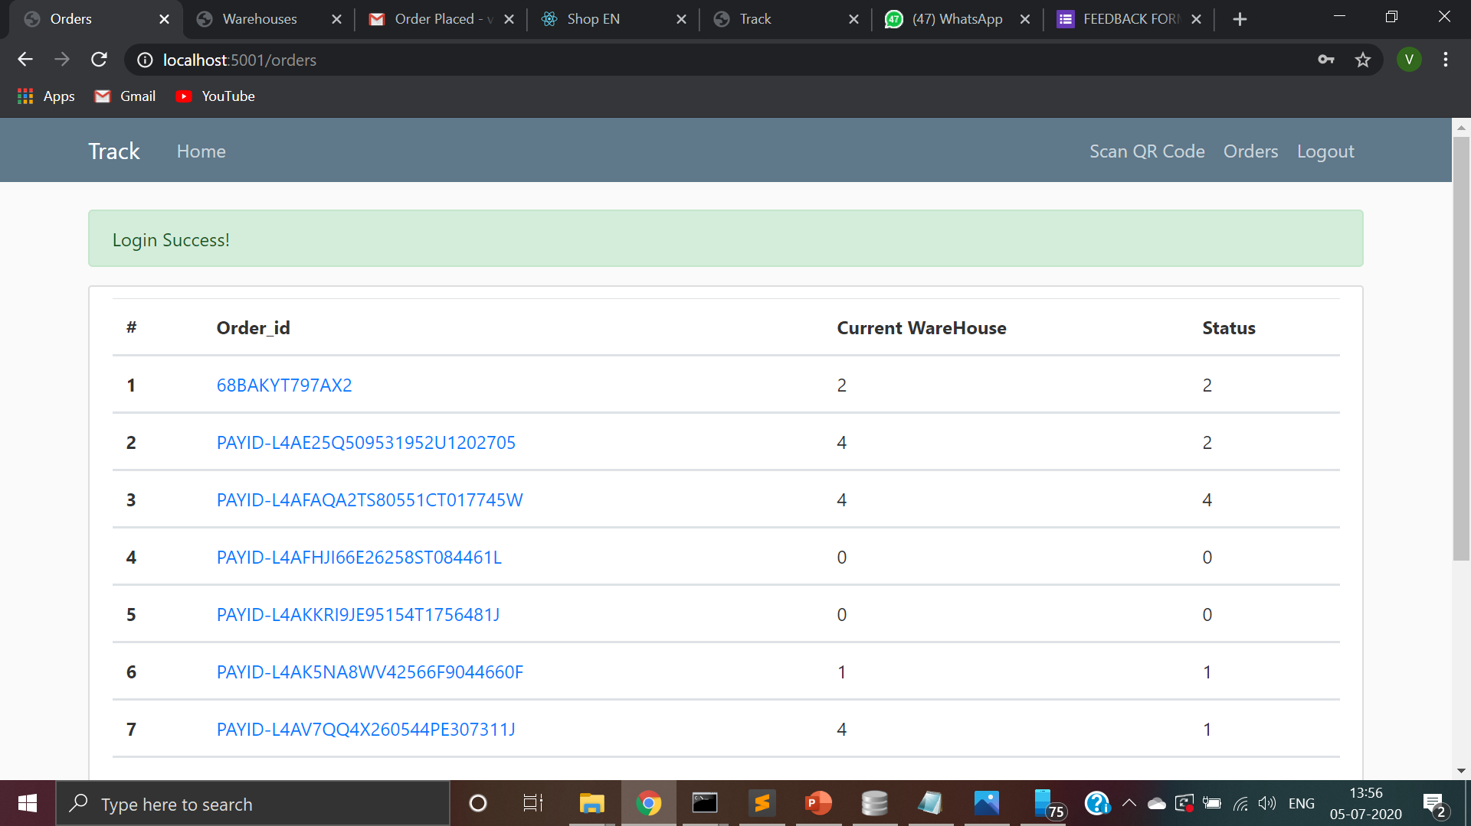
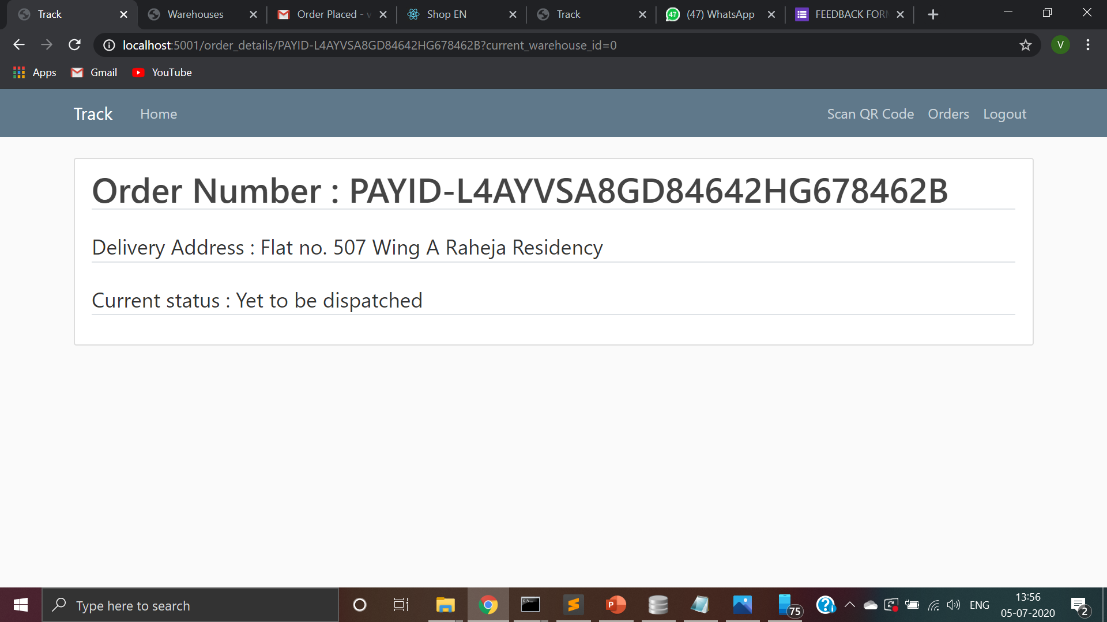
Orders and Order details

Slide 18
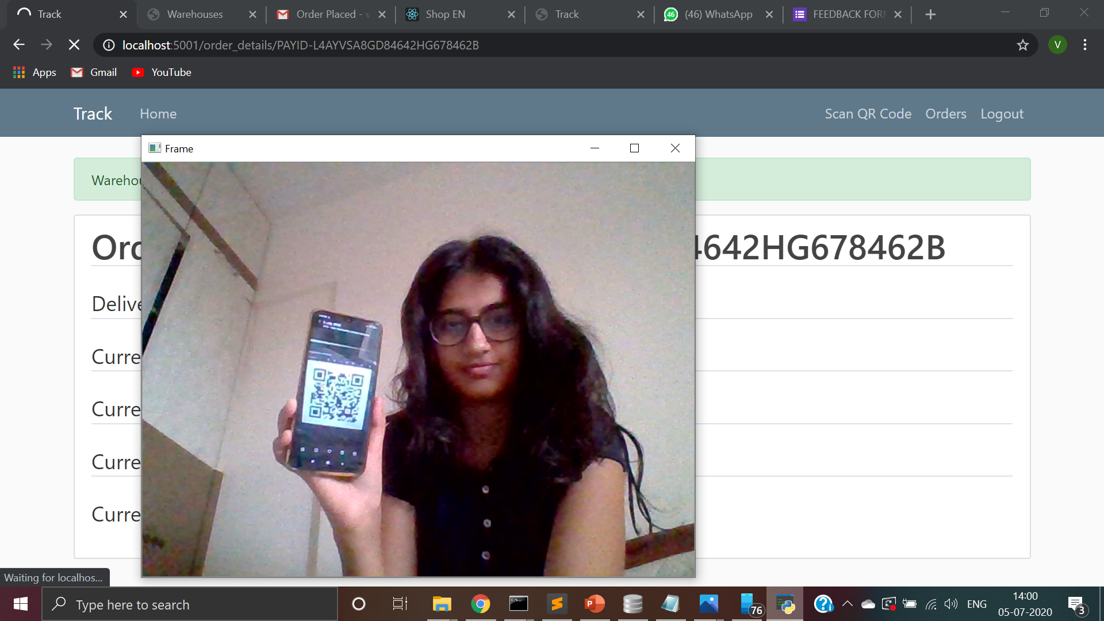
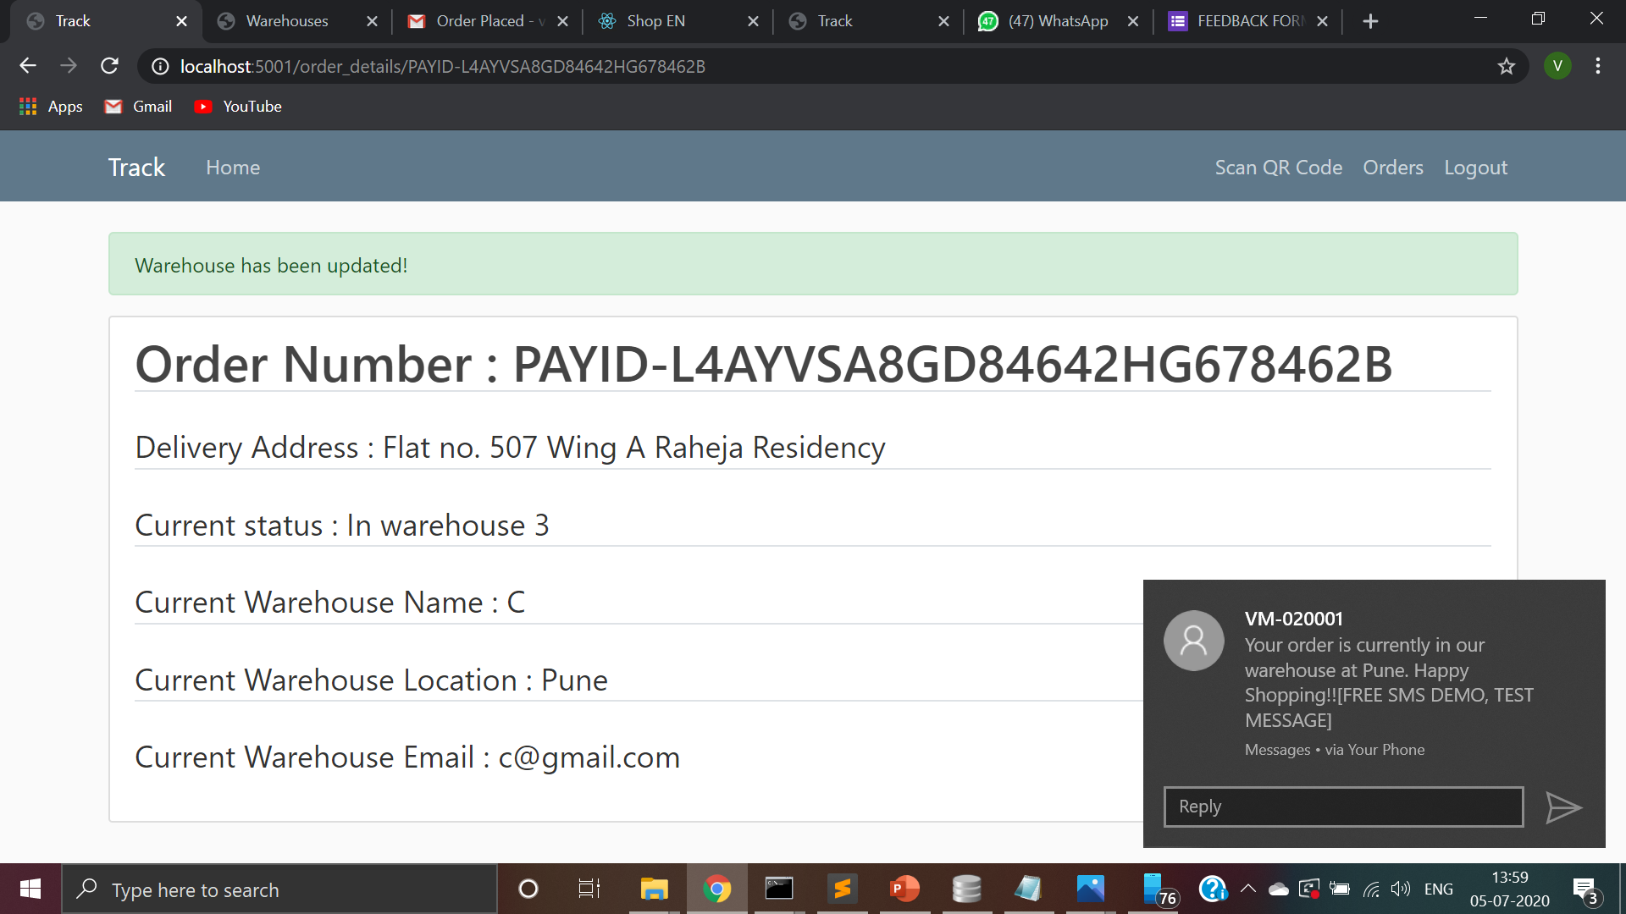
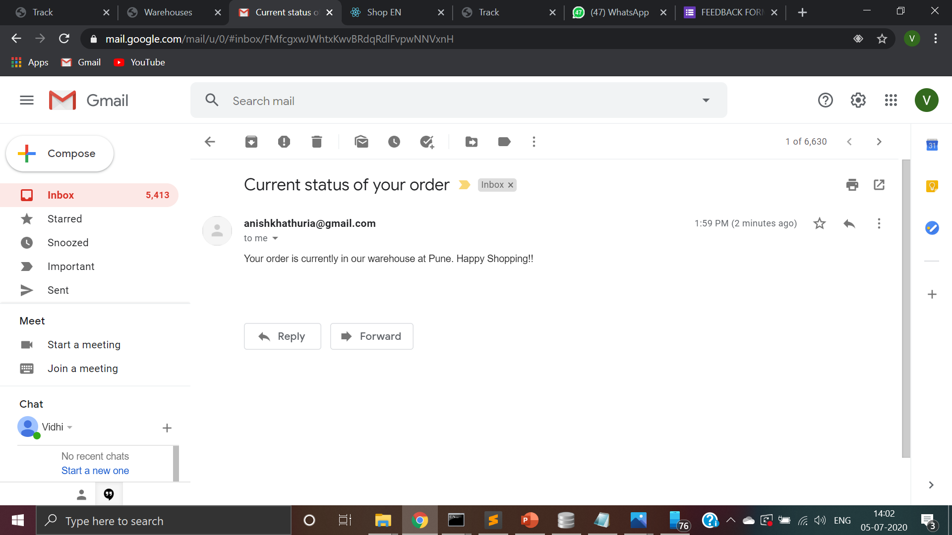
Scanning the QR code pasted on the order generated when the order was created

Slide 19
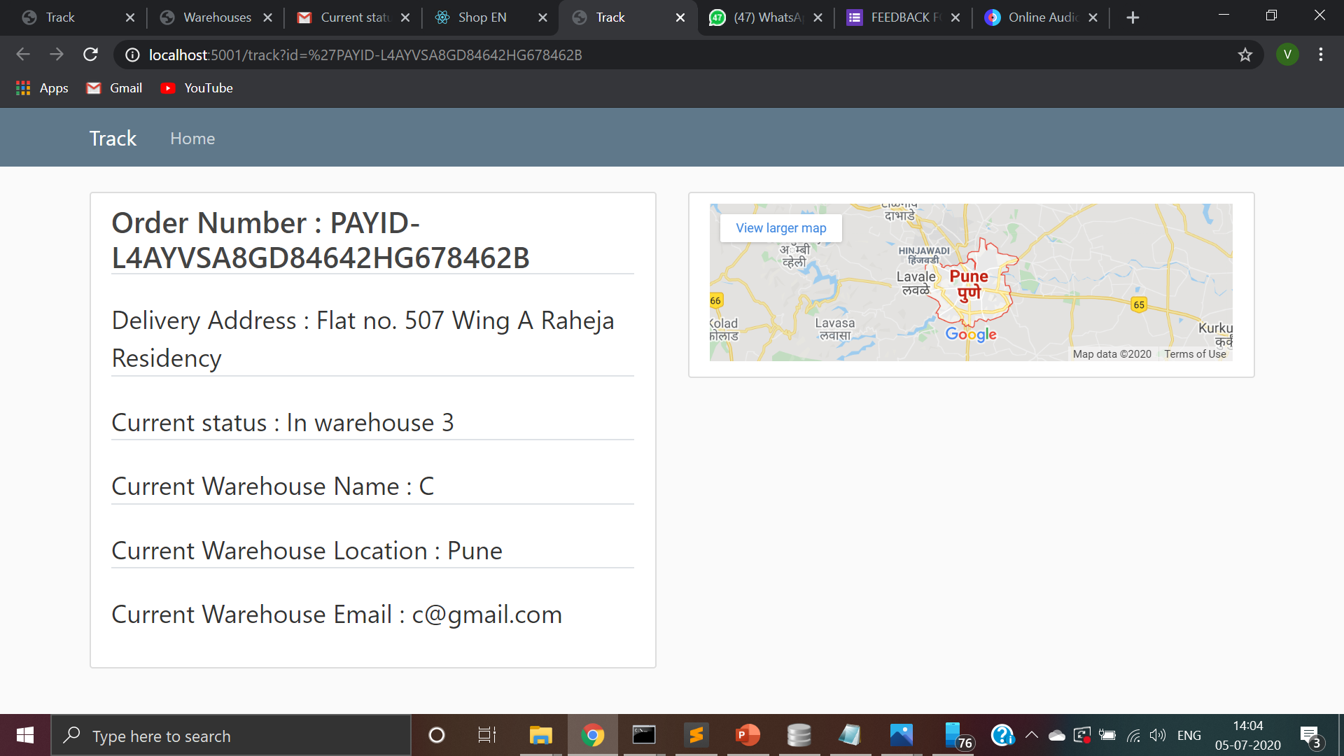
Updates on customer’s track portal

Slide 20
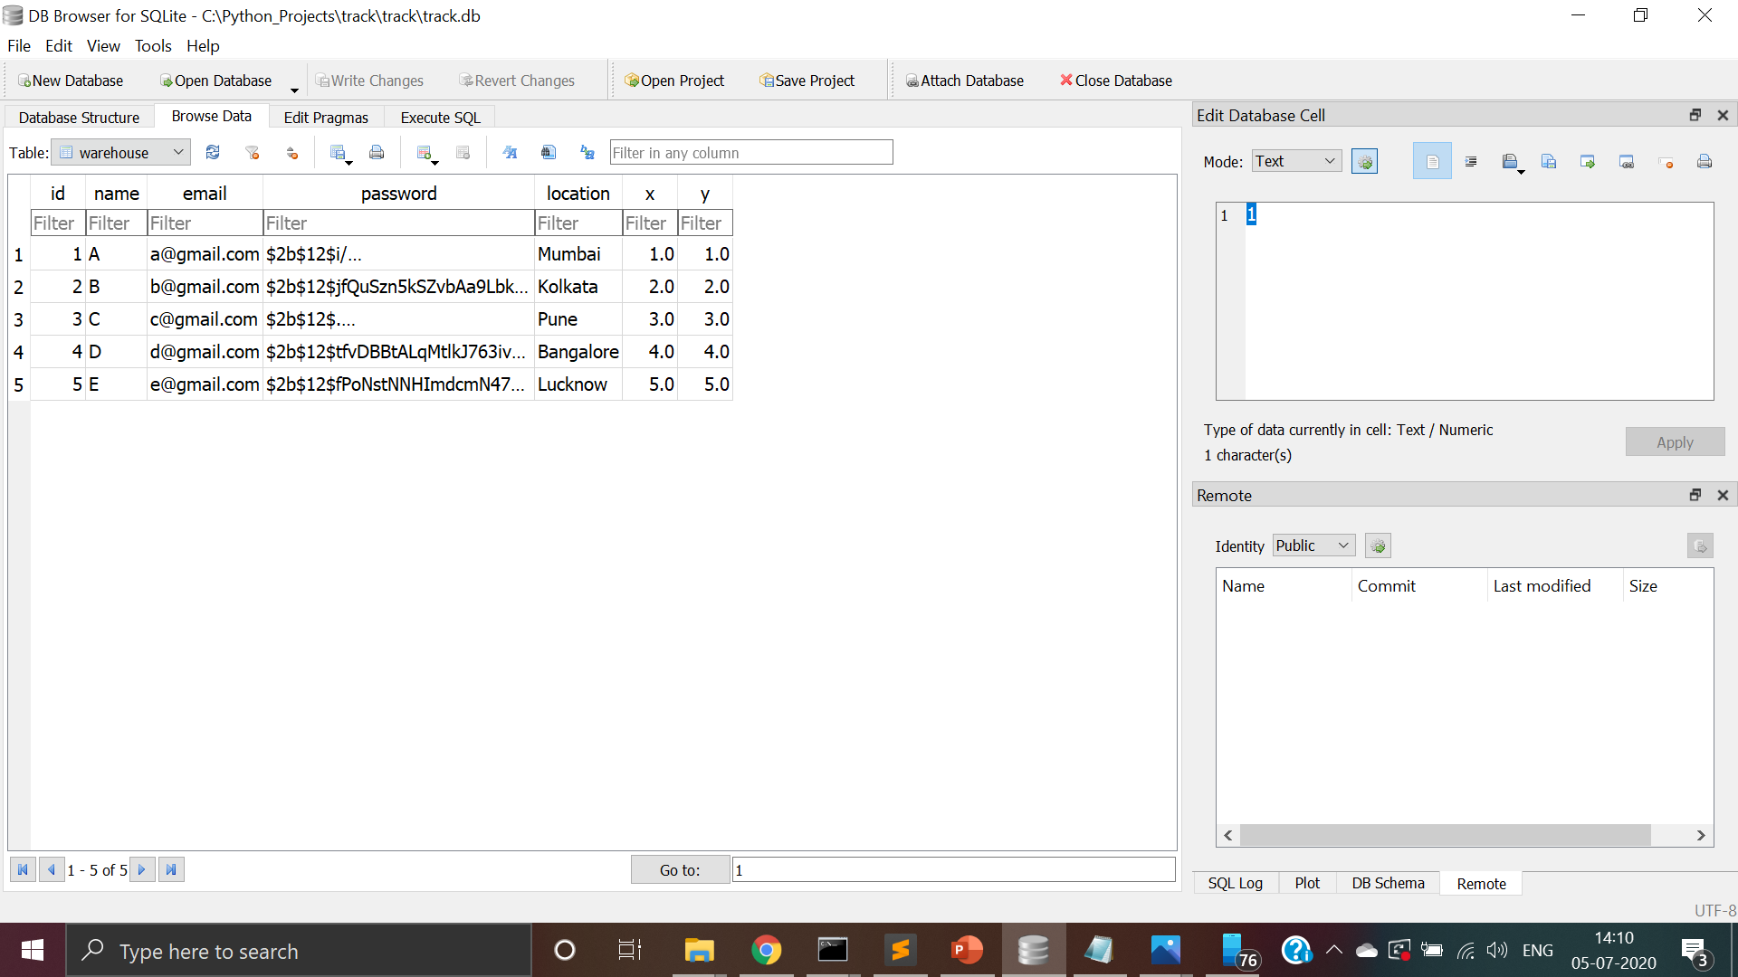
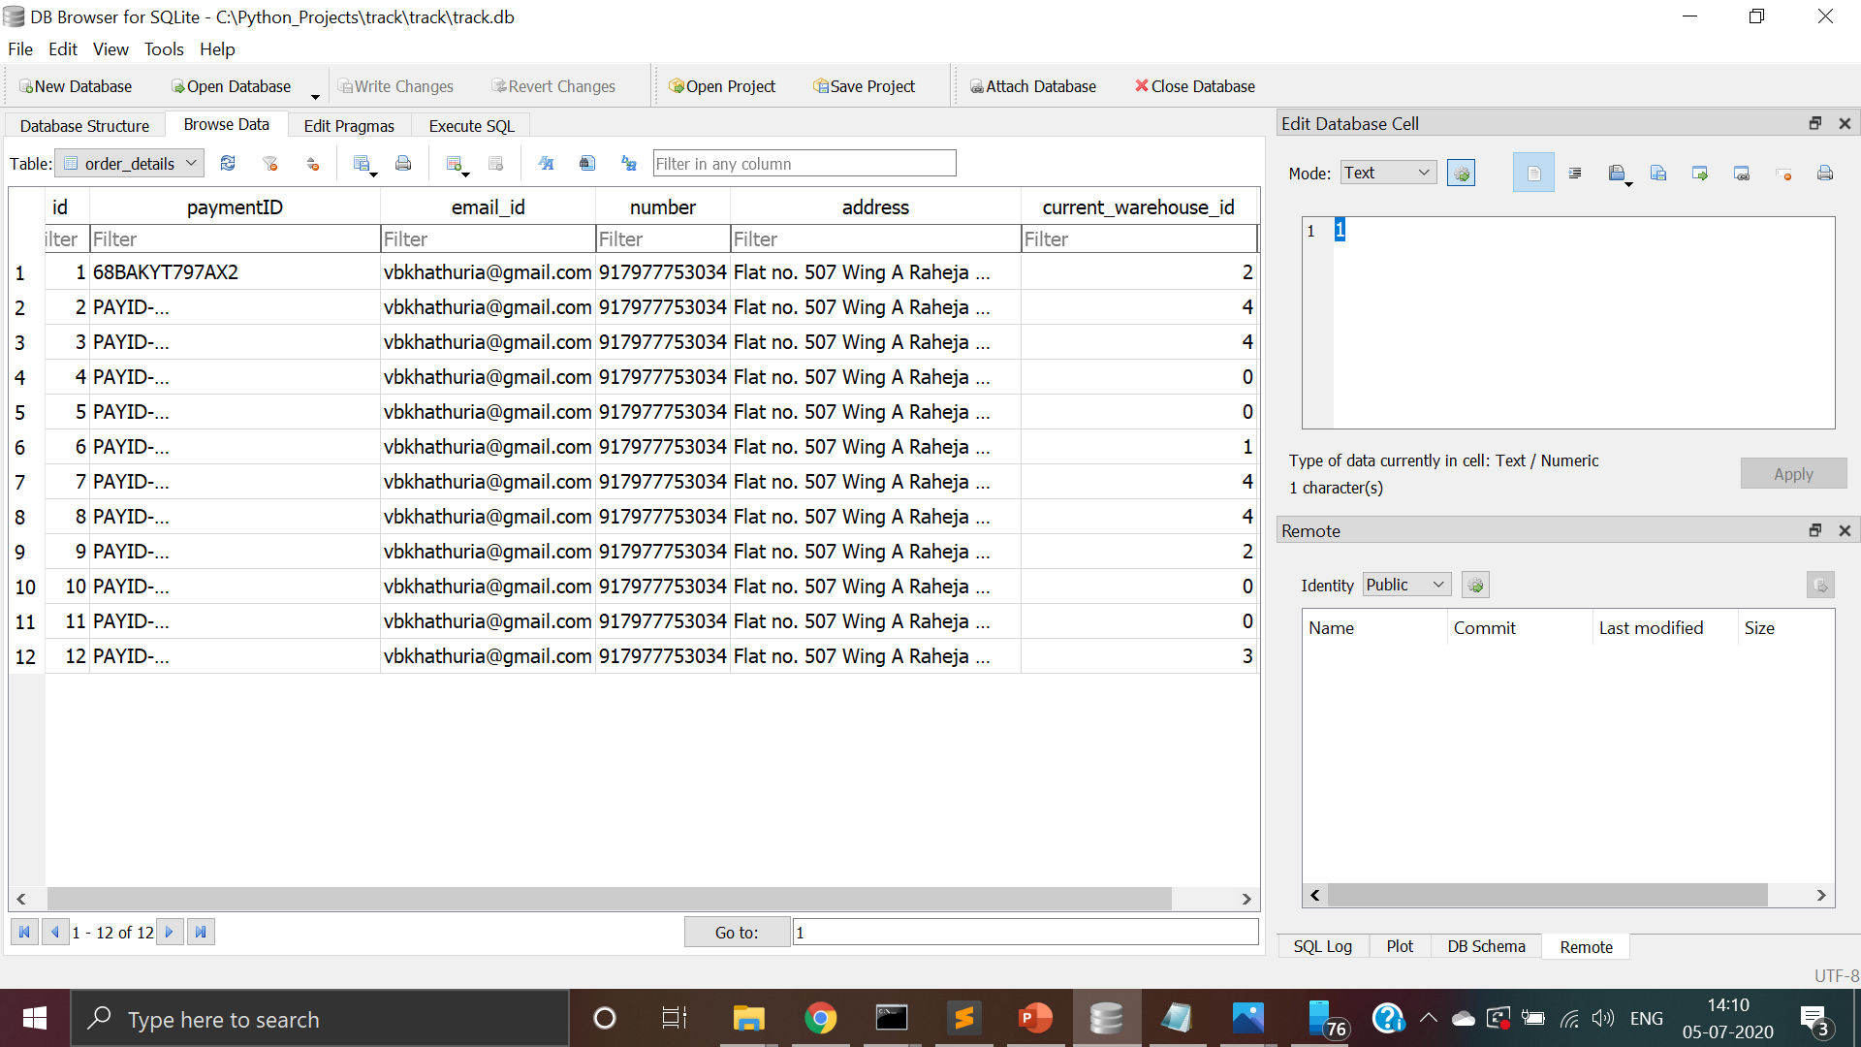
Warehouse database
Warehouse passwords have been hashed.
Orders per warehouse and their status codes can be seen in order details table.

Slide 21
How the warehouse system works
4
2
2
3
1
3
Buyer
1
Seller
4
2

Slide 22
Future Scope
We will convert this web app into a cross platform application using technologies such as react native.
We will provide app translations for people who can not understand English.
We can add a monthly sales report.
We can add order using SMS feature.

Slide 23
Thank you!

